Slide 1
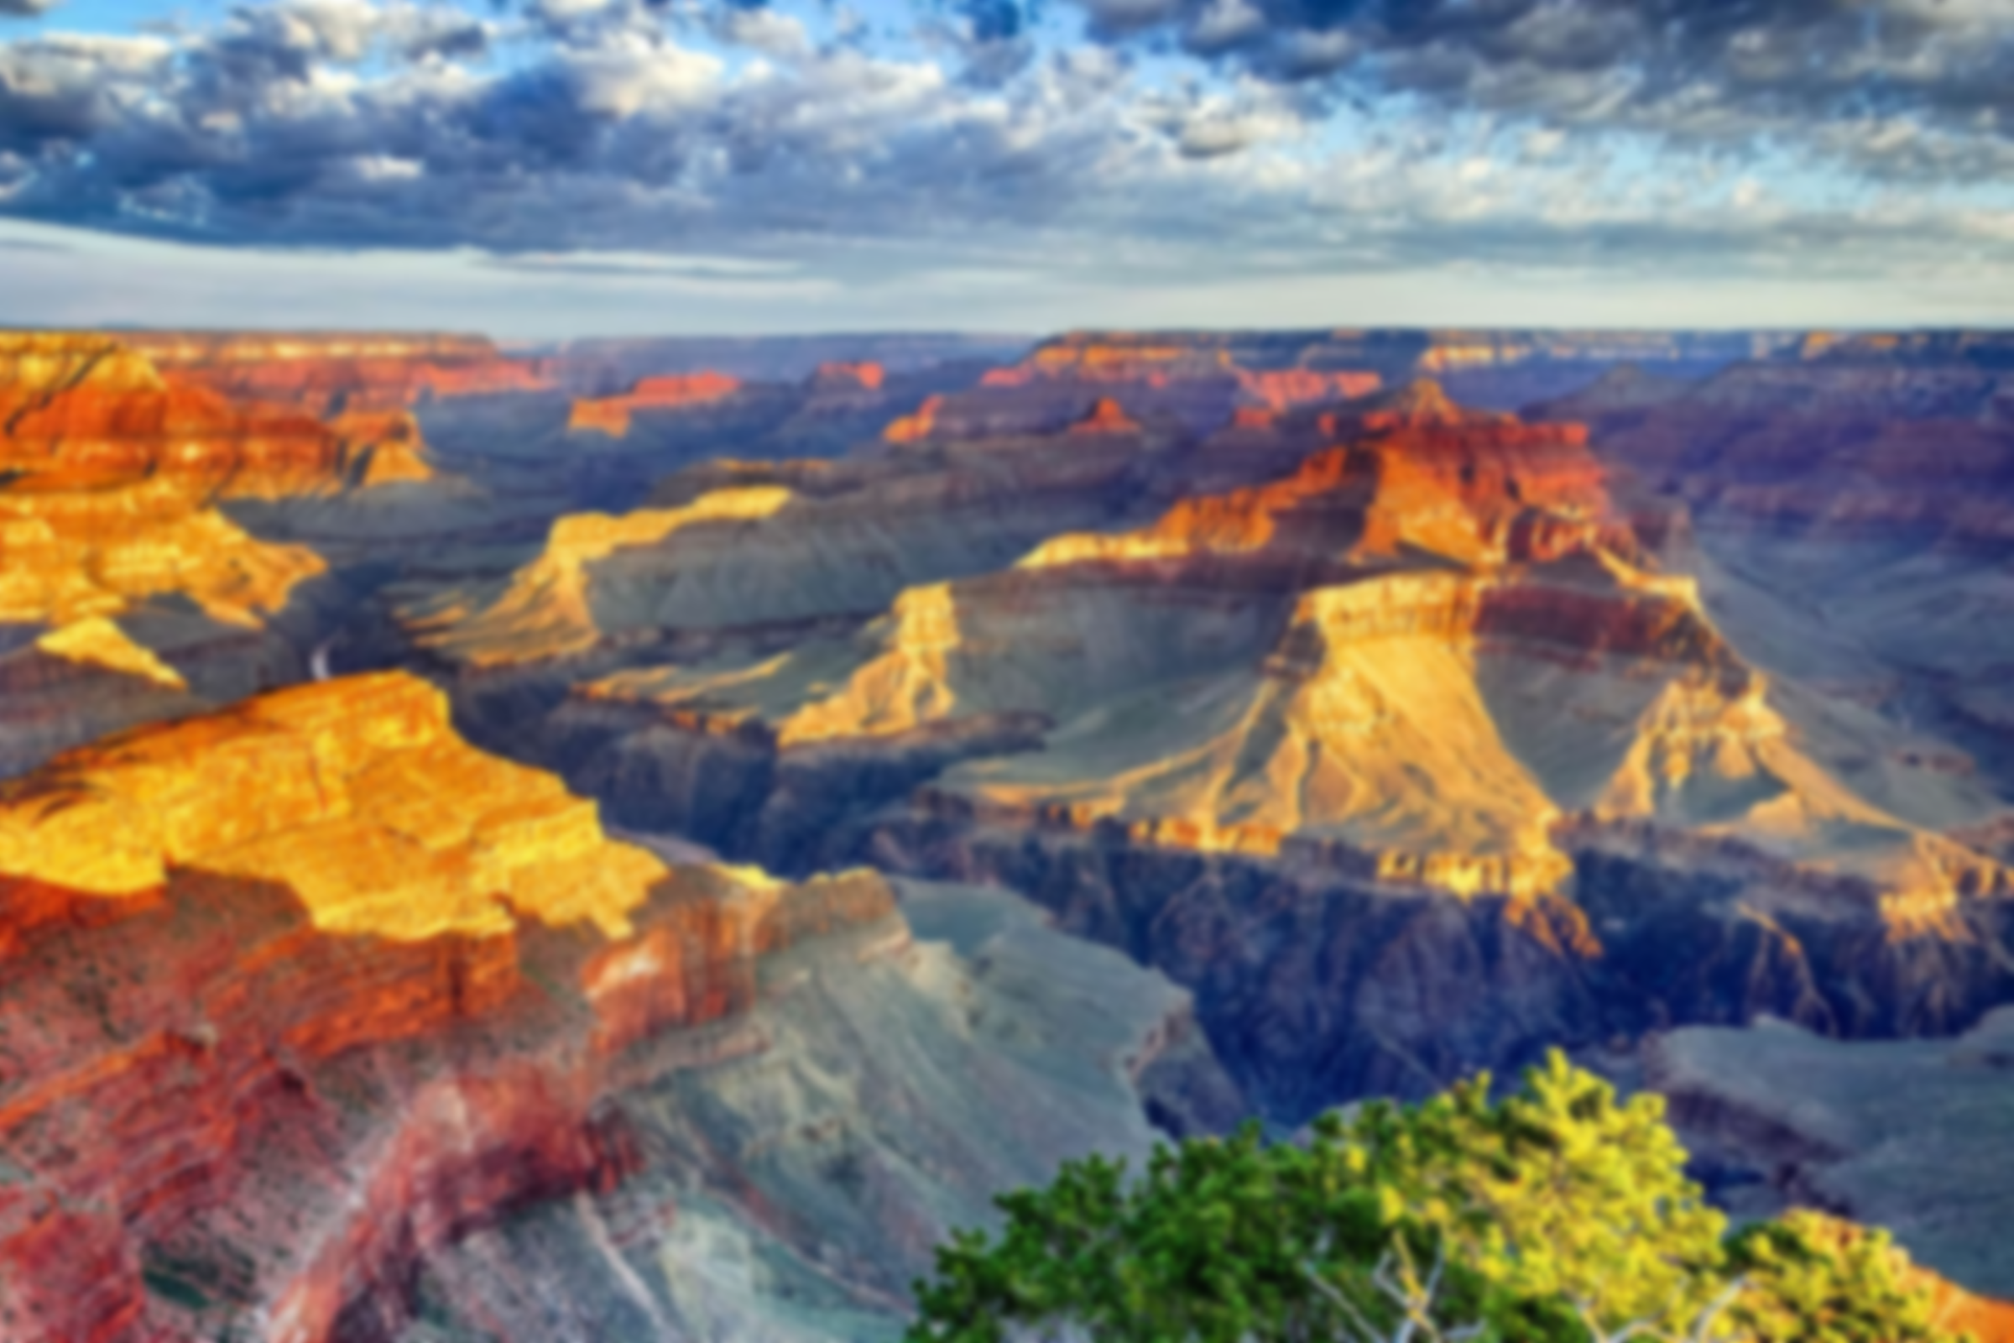
Las Vegas Field Trip 2026
Welcome to the Las Vegas Field Trip Launch Event and Information Evening

Slide 2
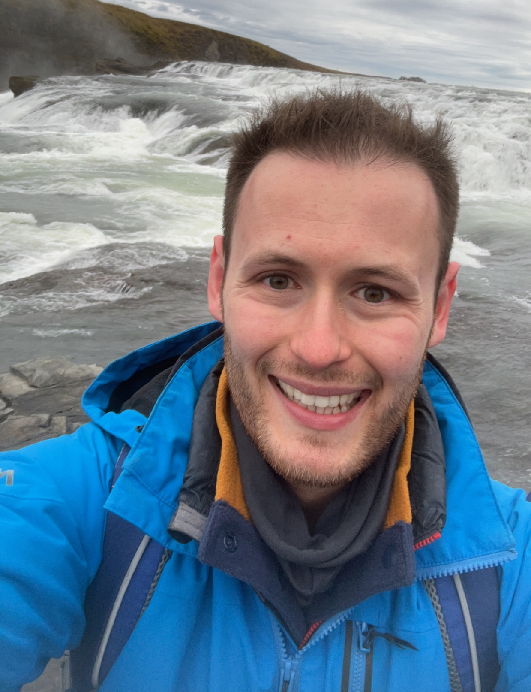
Meet the staff
Mrs. Green
Trip Lead – Idsall School
Mr. Greenfield
Trip Lead – The Grove School

Slide 3
Las Vegas 2026
The trip will run from Sunday 25th October – Friday 30th October 2026.
The trip is open to all students currently in Year 8 and Year 9, during the academic year 2024-2025.
Taking Geography at GCSE is not a pre-requisite in participating in the trip, although we would strongly recommend participants taking Geography at GSCE as this trip will support students’ understanding of key GCSE topic areas.
This is a combined trip betwen Idsall School and The Grove School, who will also be contributing students to the trip.

Slide 4
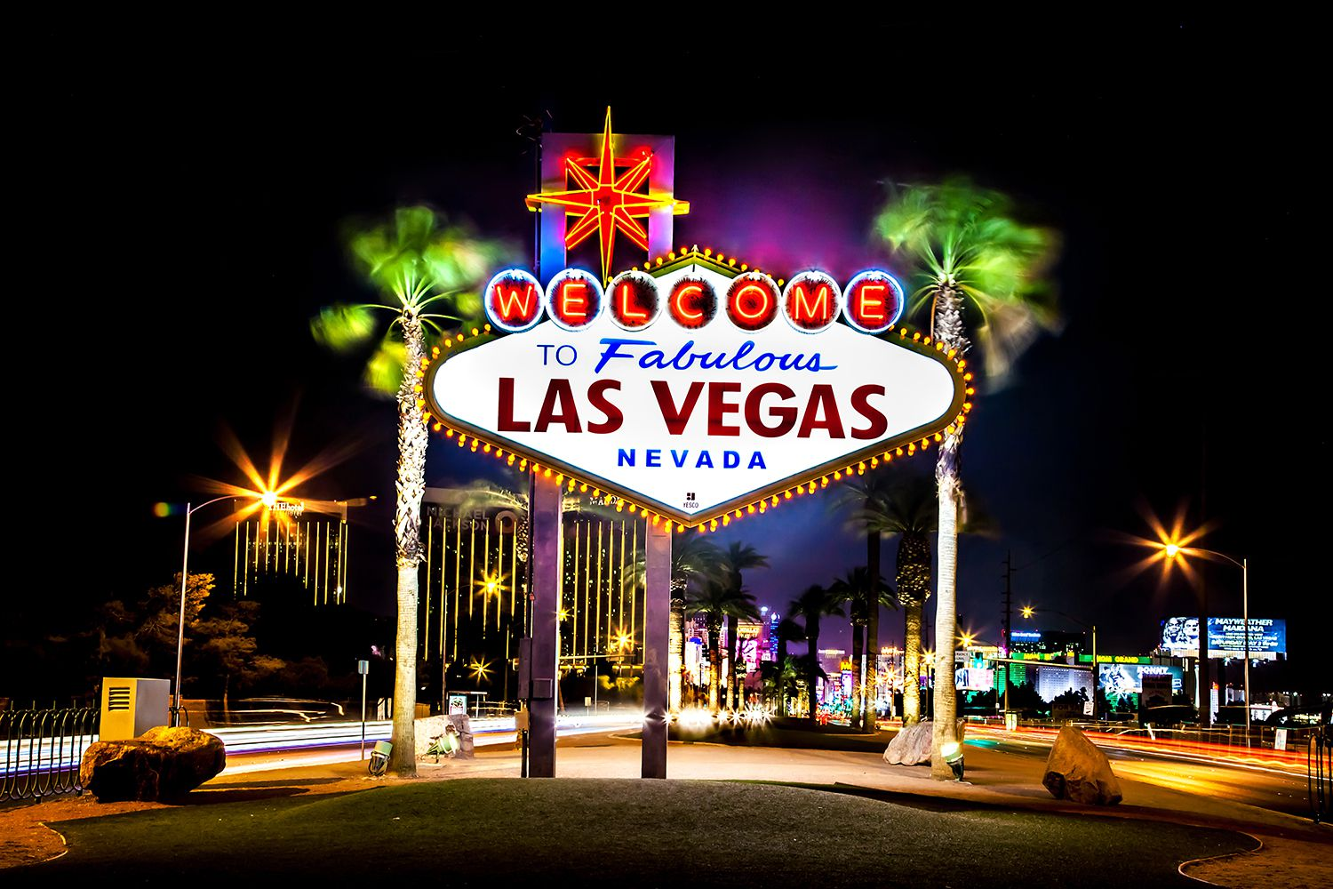
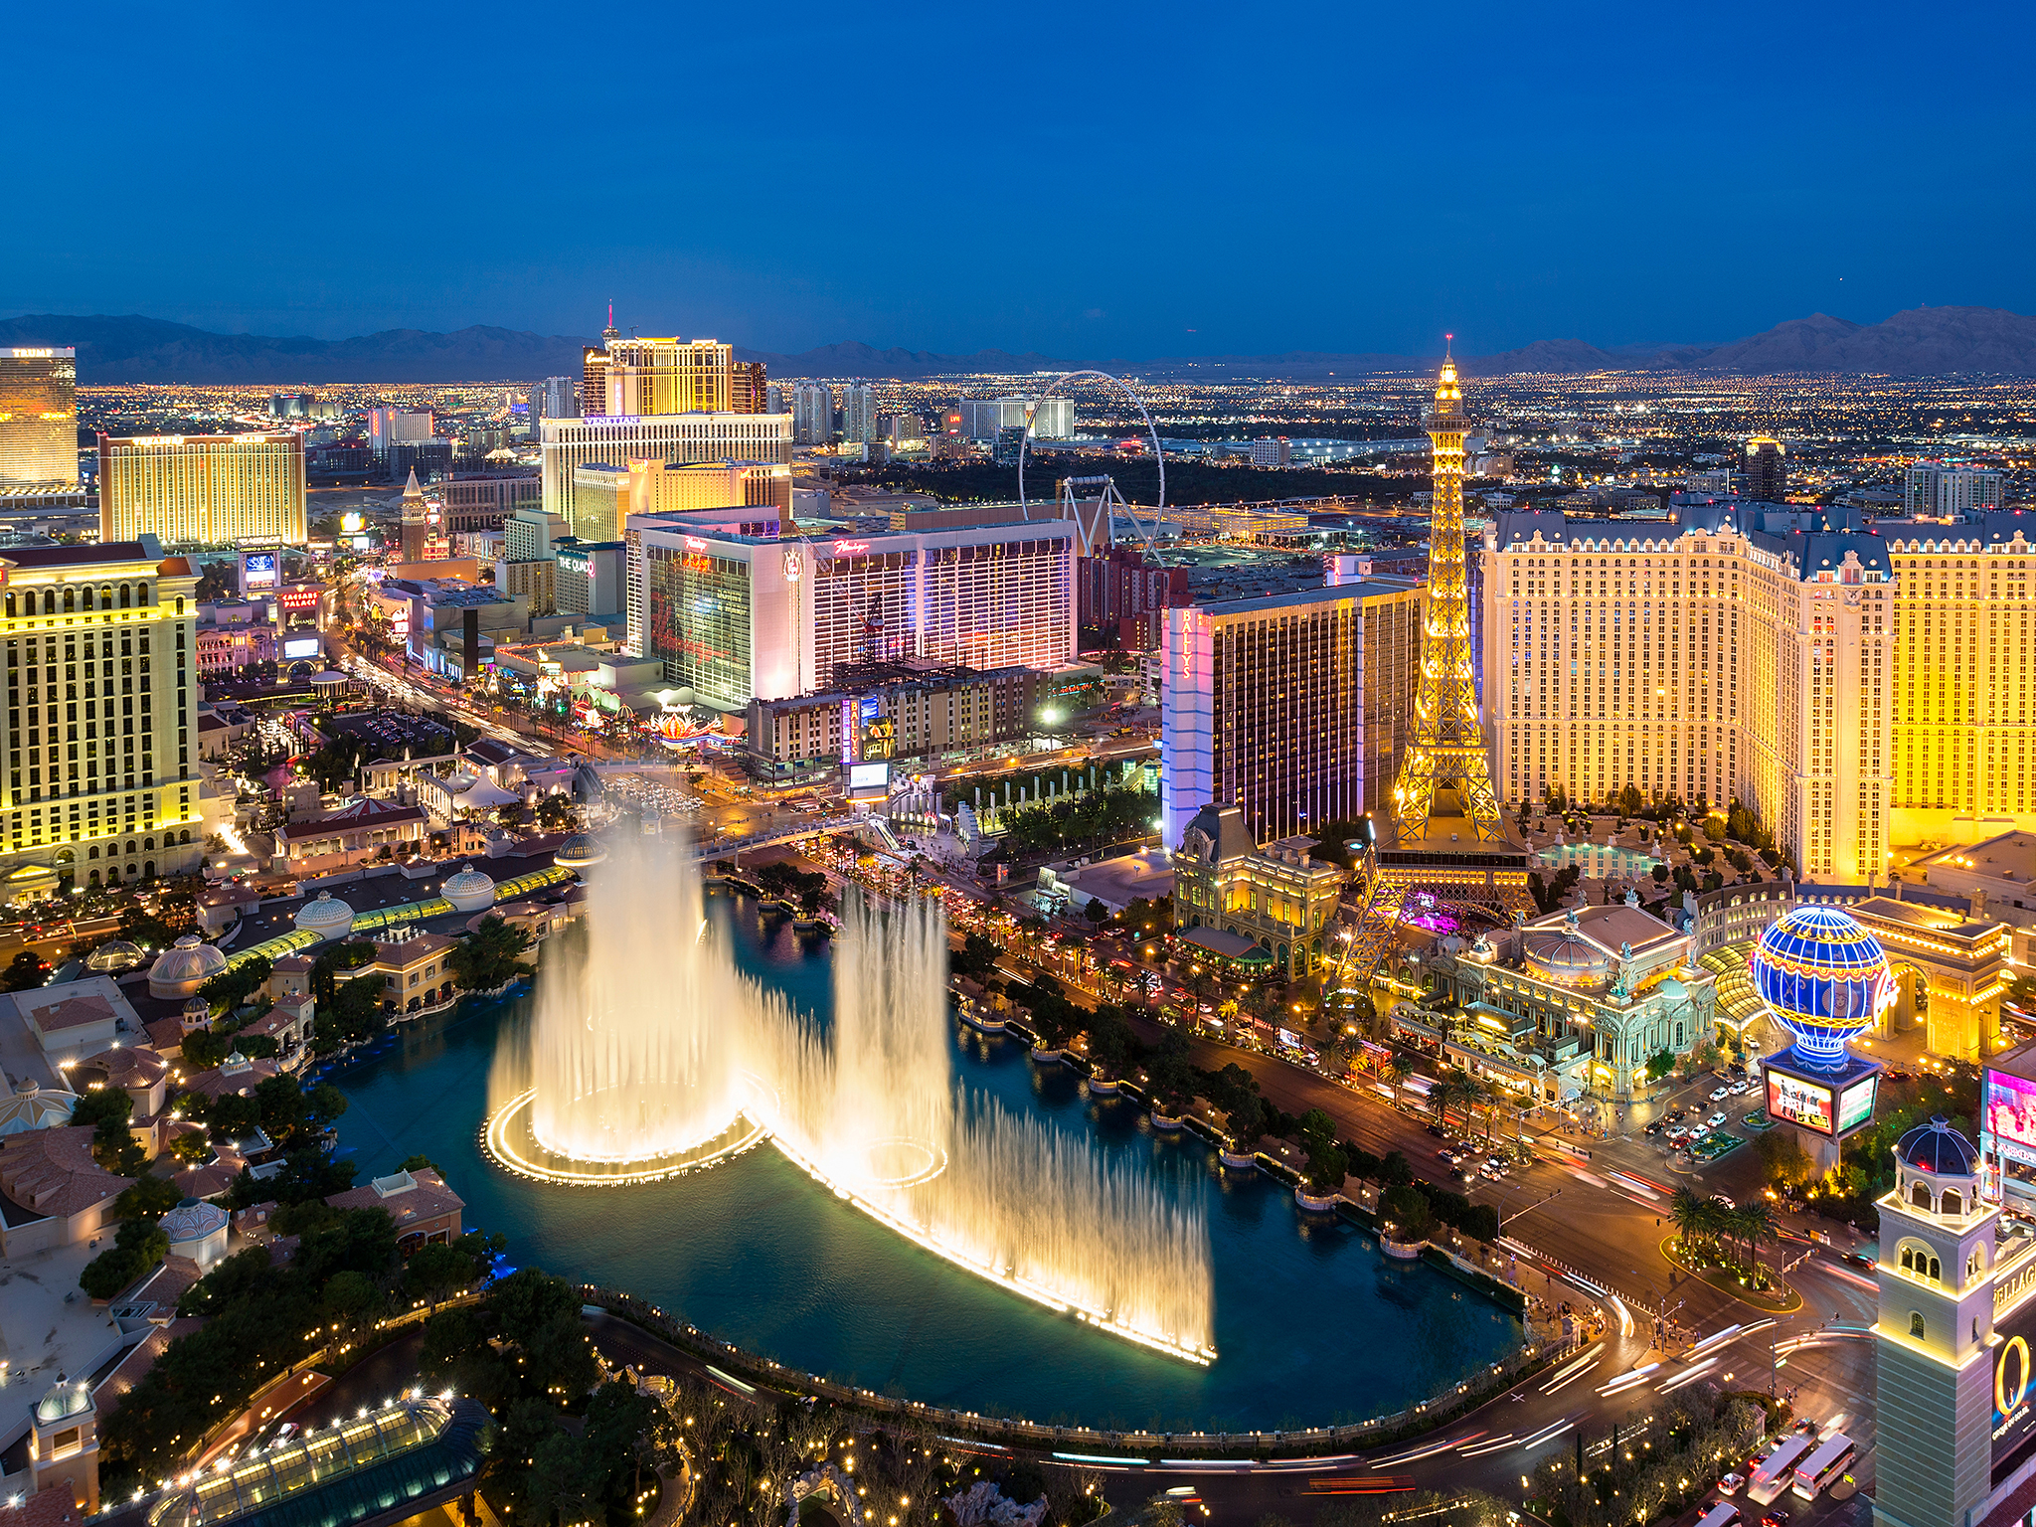
Why Las Vegas?
Las Vegas is a perfect base for visiting geographical features, such as The Grand Canyon, Lake Mead, the Hoover Dam, Death Valley National Park
This trip also offers students with the cultural experience of visiting the USA.

Slide 5
We will be travelling with NST
Established 1967 - over 45 years’ experience
Government recommended health and safety policy
ABTA and ATOL protected - your payments are insured
Insurance cover and 24-hour medical assistance cover

Slide 6
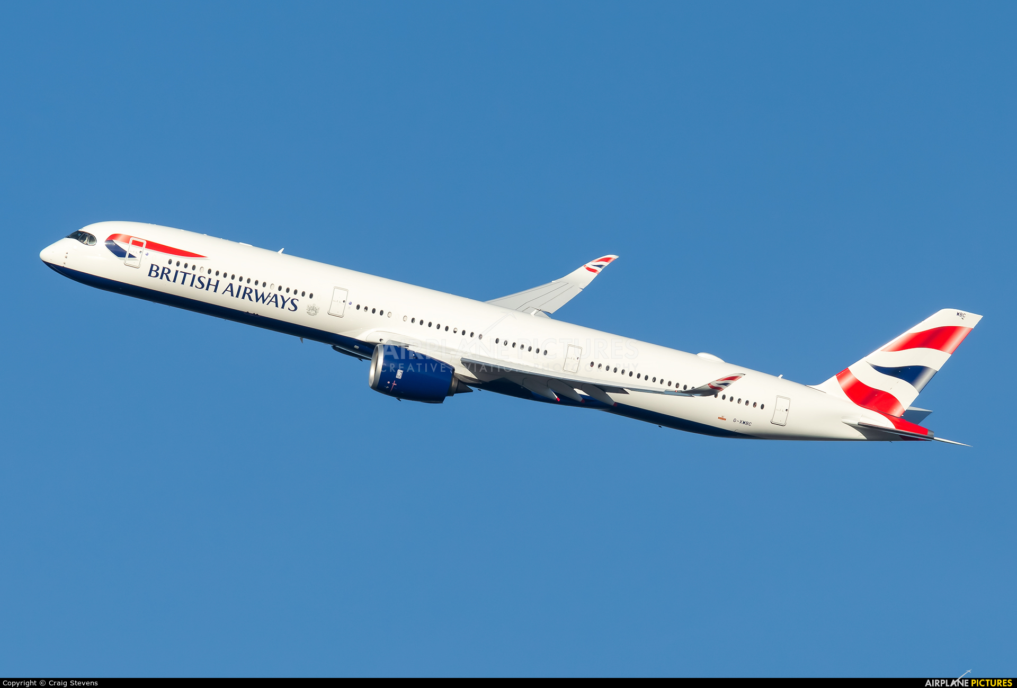
Travelling to and from Las Vegas
The coach will leave Idsall School car park early on Sunday 25th October – coach transfer to London Heathrow.
Flight time from London to Las Vegas around 10hours.
Coach transfer will then bring us back to Idsall School from Heathrow on Friday 30th October.

Slide 7
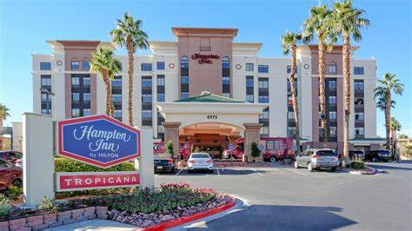
Where will we be staying?
Our accommodation will be Hampton Inn Tropicana, which is towards the south of Las Vegas.
Accommodation will be in dormitories, with students sharing.

Slide 8
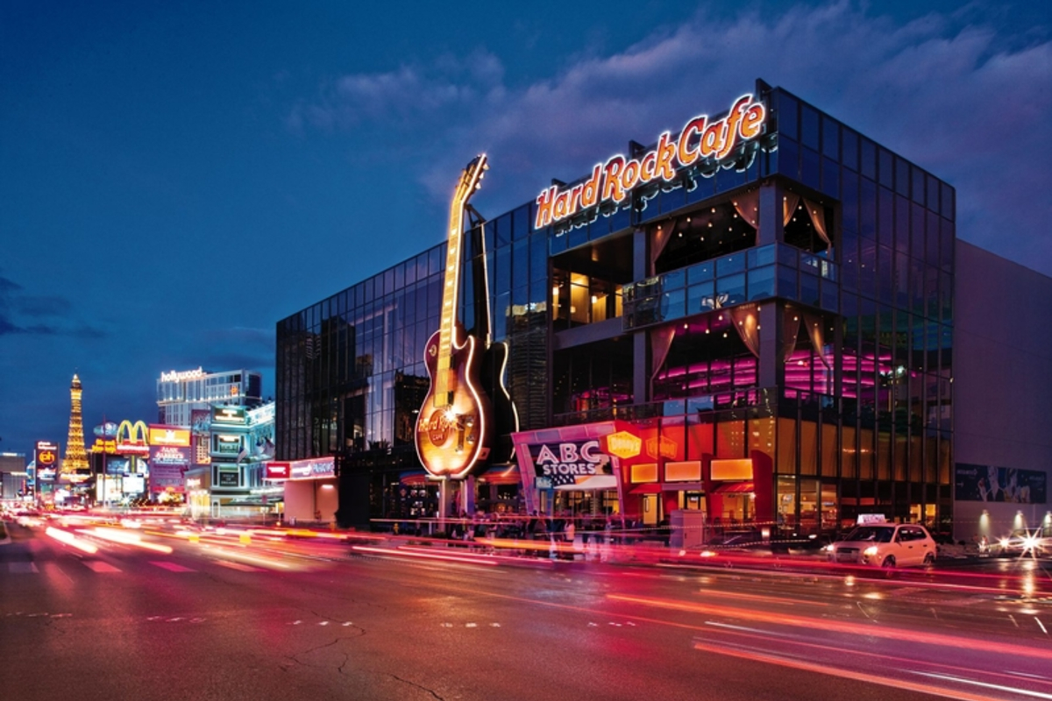
What will we be eating?
The trip is full board, with all meals included.
Breakfast will be continental.
Packed lunches will be provided – these will be made up at breakfast for us to take out to eat during the day.
Please make us aware of any student allergies or food intolerances before departure.
Evening meals are included, and these will be eaten at local restaurants, such as the Hard Rock Café.

Slide 9
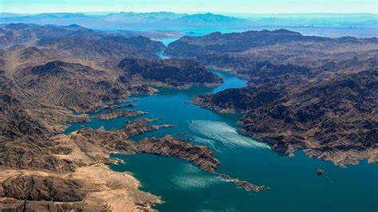
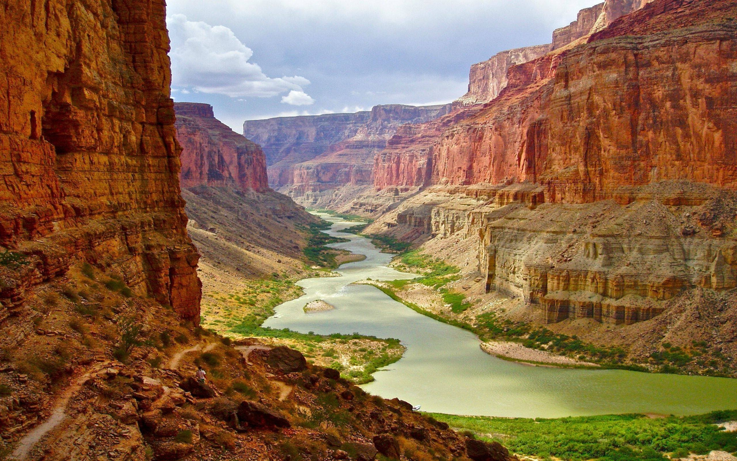
The itinerary
We will be visiting The Grand Canyon, Death Valley National Park, Hoover Dam Visitor Centre and touring the powerplant, and Lake Mead.
All transfers and guides are included.

Slide 10
Visas and Passports
Conditions to the ESTA visa:
You cannot normally apply for an ESTA visa waiver if you were in the following countries on or after March 2011:
Iran
Iraq
Libya
North Korea
Somalia
Sudan
Syria
Yemen
You cannot apply for an ESTA visa waiver if you travelled to or were in Cuba on or after 12 January 2021.
If you are not eligible for an ESTA, you must instead apply for a US visa.
You must have a valid passport, with a minimum of 6 months remaining at time of return to the UK.
Everyone travelling to the USA must also have an ESTA (Electronic System for Travel Authorisation) visa. These cost £16 ($21) – this cost is not included in the overall trip price, and the visa will need to be applied for by parents/carers – this needs to be done at least 72 hours before travel.
Do not apply until directed by school – we will provide instructions on when to apply in case there are future changes over the application procedure.
More information can be found on the Foreign and Commonwealth Office website.

Slide 11
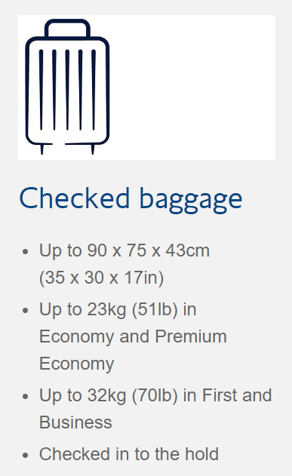
Luggage
We have 23KG of checked baggage which will be placed in the aircraft hold, and will be handed in at the check in desk. These must have your name on it (name tag) and keep the keys safe if you are using a lock!
You are also able to take a small personal item on board the cabin which must not exceed 40 x 20 x 25cm. It must fit under the seat in front of you.

Slide 12
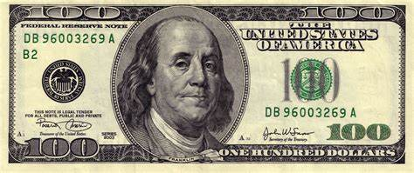
Spending money
The schedule is very busy and there will be travelling time between sites. Bring snacks (cereal bars, dried fruit, nuts, sweets etc.). There will be limited opportunities to buy snacks/souvenirs.
Suggested £100: £30 for meal and drink in Heathrow and Las Vegas airports, £10 snacks + souvenirs + tips – your choice.
The USA is card friendly – pre-loaded card suggested e.g. Monzo
Get your money split between Sterling and dollars.
Your money is your responsibility – use a money-belt/wallet safely stored/zipped – so it doesn’t fall out!

Slide 13
What is the cost of the trip?
Date payment is due | Amount
15th November 2024 | £150
15th December 2024 | £105
28th January 2025 | £120
28th February 2025 | £120
28th March 2025 | £120
28th April 2025 | £120
28th May 2025 | £120
28th June 2025 | £120
July 2025 | No payment
August 2025 | No payment
28th September 2025 | £120
28th October 2025 | £120
28th November 2025 | £120
28th December 2025 | £100
28th January 2026 | £120
28th February 2026 | £120
28th March 2026 | £150
28th April 2026 | £150
28th May 2026 | £150
28th June 2026 | £150
The total cost of the trip is £2,270.
Payments vary depending on the time of year.
No payment is taken for July and August 2025, and reduced payments for Christmas periods.
Final payment is June 2026.
In the eventuality of a cancellation, the amount refunded would depend on how close it is to the departure date.
More information can be provided by speaking with Mrs. Green.
Tipping is a big cultural feature in the USA.
Staff will control tips for the group. Students would not need to factor this into their spending money.
Notes:
90 = 2341 – 150 = 2191/22 = 95.26

Slide 14
Use of mobile phones and electronics
Students can take their mobile phones on the trip.
Take lots of pictures!
Be careful of data uses though – roaming charges may be different as we will be in the USA.
Make sure you have the correct charging adapter.
It will be your responsibility to look after your phones and electronic devices. Staff will not be held responsible for any damaged or lost property.

Slide 15
Insurances
The trip is fully insured by NST (through Aviva) and Trust insurance policies too.
This includes:
Medical
Personal Belongings
Money
Cancellation
Travel delays
Any changes in terms of transfers, guides, airline, accommodation etc. will be covered by NST too.

Slide 16
Code of Conduct
All students and parents/carers will be expected to sign and date the Code of Conduct form.
Students will be expected to behave to the highest standard – they are representing both our two schools.
Any concerns regarding behaviour could result in parents/carers being invited in for a meeting to discuss concerns or being removed from the trip.

Slide 17
If you think of any questions, please email me at: shaun.greenfield@gro.mmat.co.uk
violet.green@ids.mmat.co.uk .
Thank you for coming this evening, it was lovely to see you!
We hope you all choose to join us for an epic US adventure!

