Slide 1
WELCOME TO IDSALL SCHOOL
NEWSLETTER – From Inside the Kitchen
We are delighted to be sharing with you our second newsletter for this academic year , keeping you updated with what’s coming up & an overview of what’s been going on
MORE THAN FOOD
Firstly, we are caterers , but we believe what we do is more than just food
We are in a unique position to be able to nurture & educate through the food we serve
Forming healthy eating habits is a valuable part of your child’s education
90% of the food we serve is freshly prepared on site daily & is in line with British Government school guidelines giving your children the fuel to succeed
INSIGHT & INNOVATION
The food that we serve is shaped to reflect the latest world trends & create our own version of high street brands as well as serving the ever popular traditional menu
We have a full calendar of events including seasonal campaigns & theme days
A PARTNERSHIP
Most importantly we are here to be a part of Idsall school community , if your child has any specific dietary requirements, we are more than happy to answer any questions .
Above all, we are here to ensure that the food we serve is tasty, the pupils are happy and that we make dining at Idsall enjoyable !
Warm Wishes,
Lynsey Harper
Catering Manager| Aramark
Harper-lyn@aramark.co.uk

Slide 2
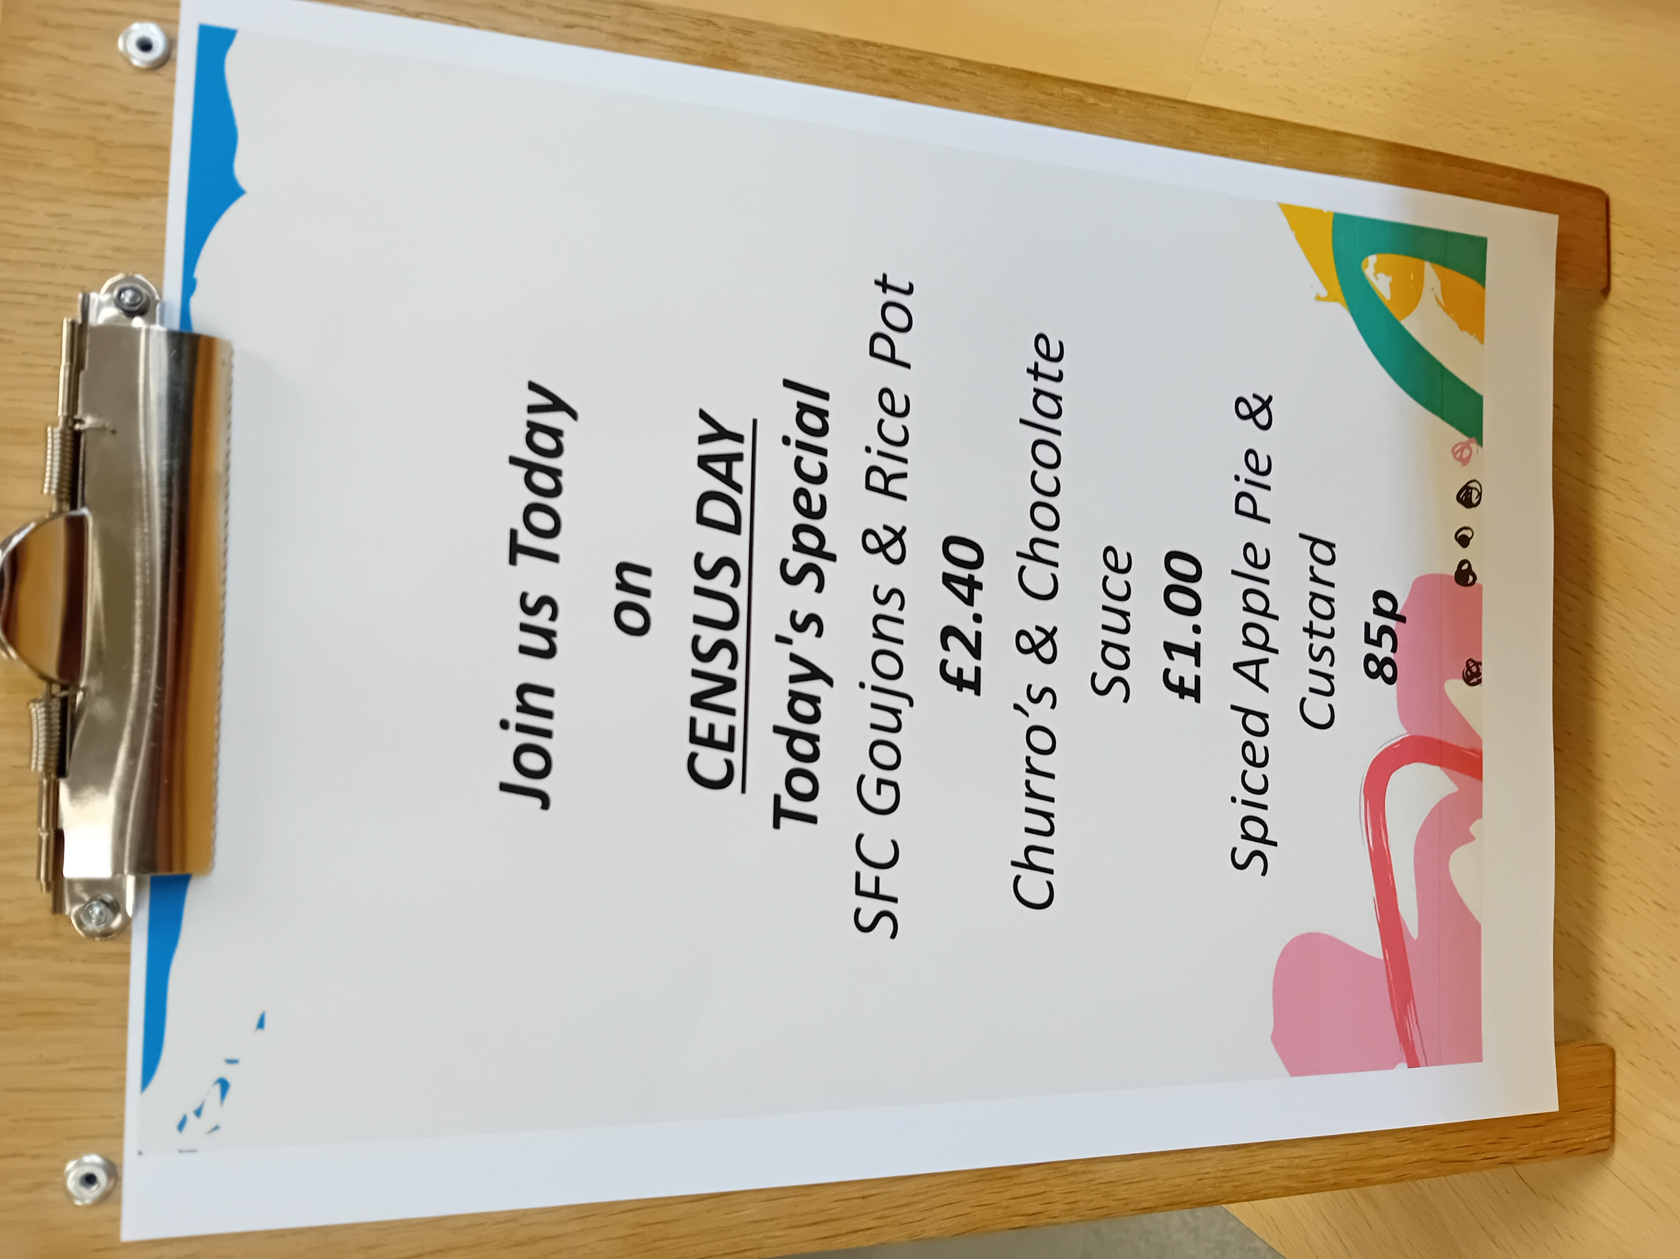
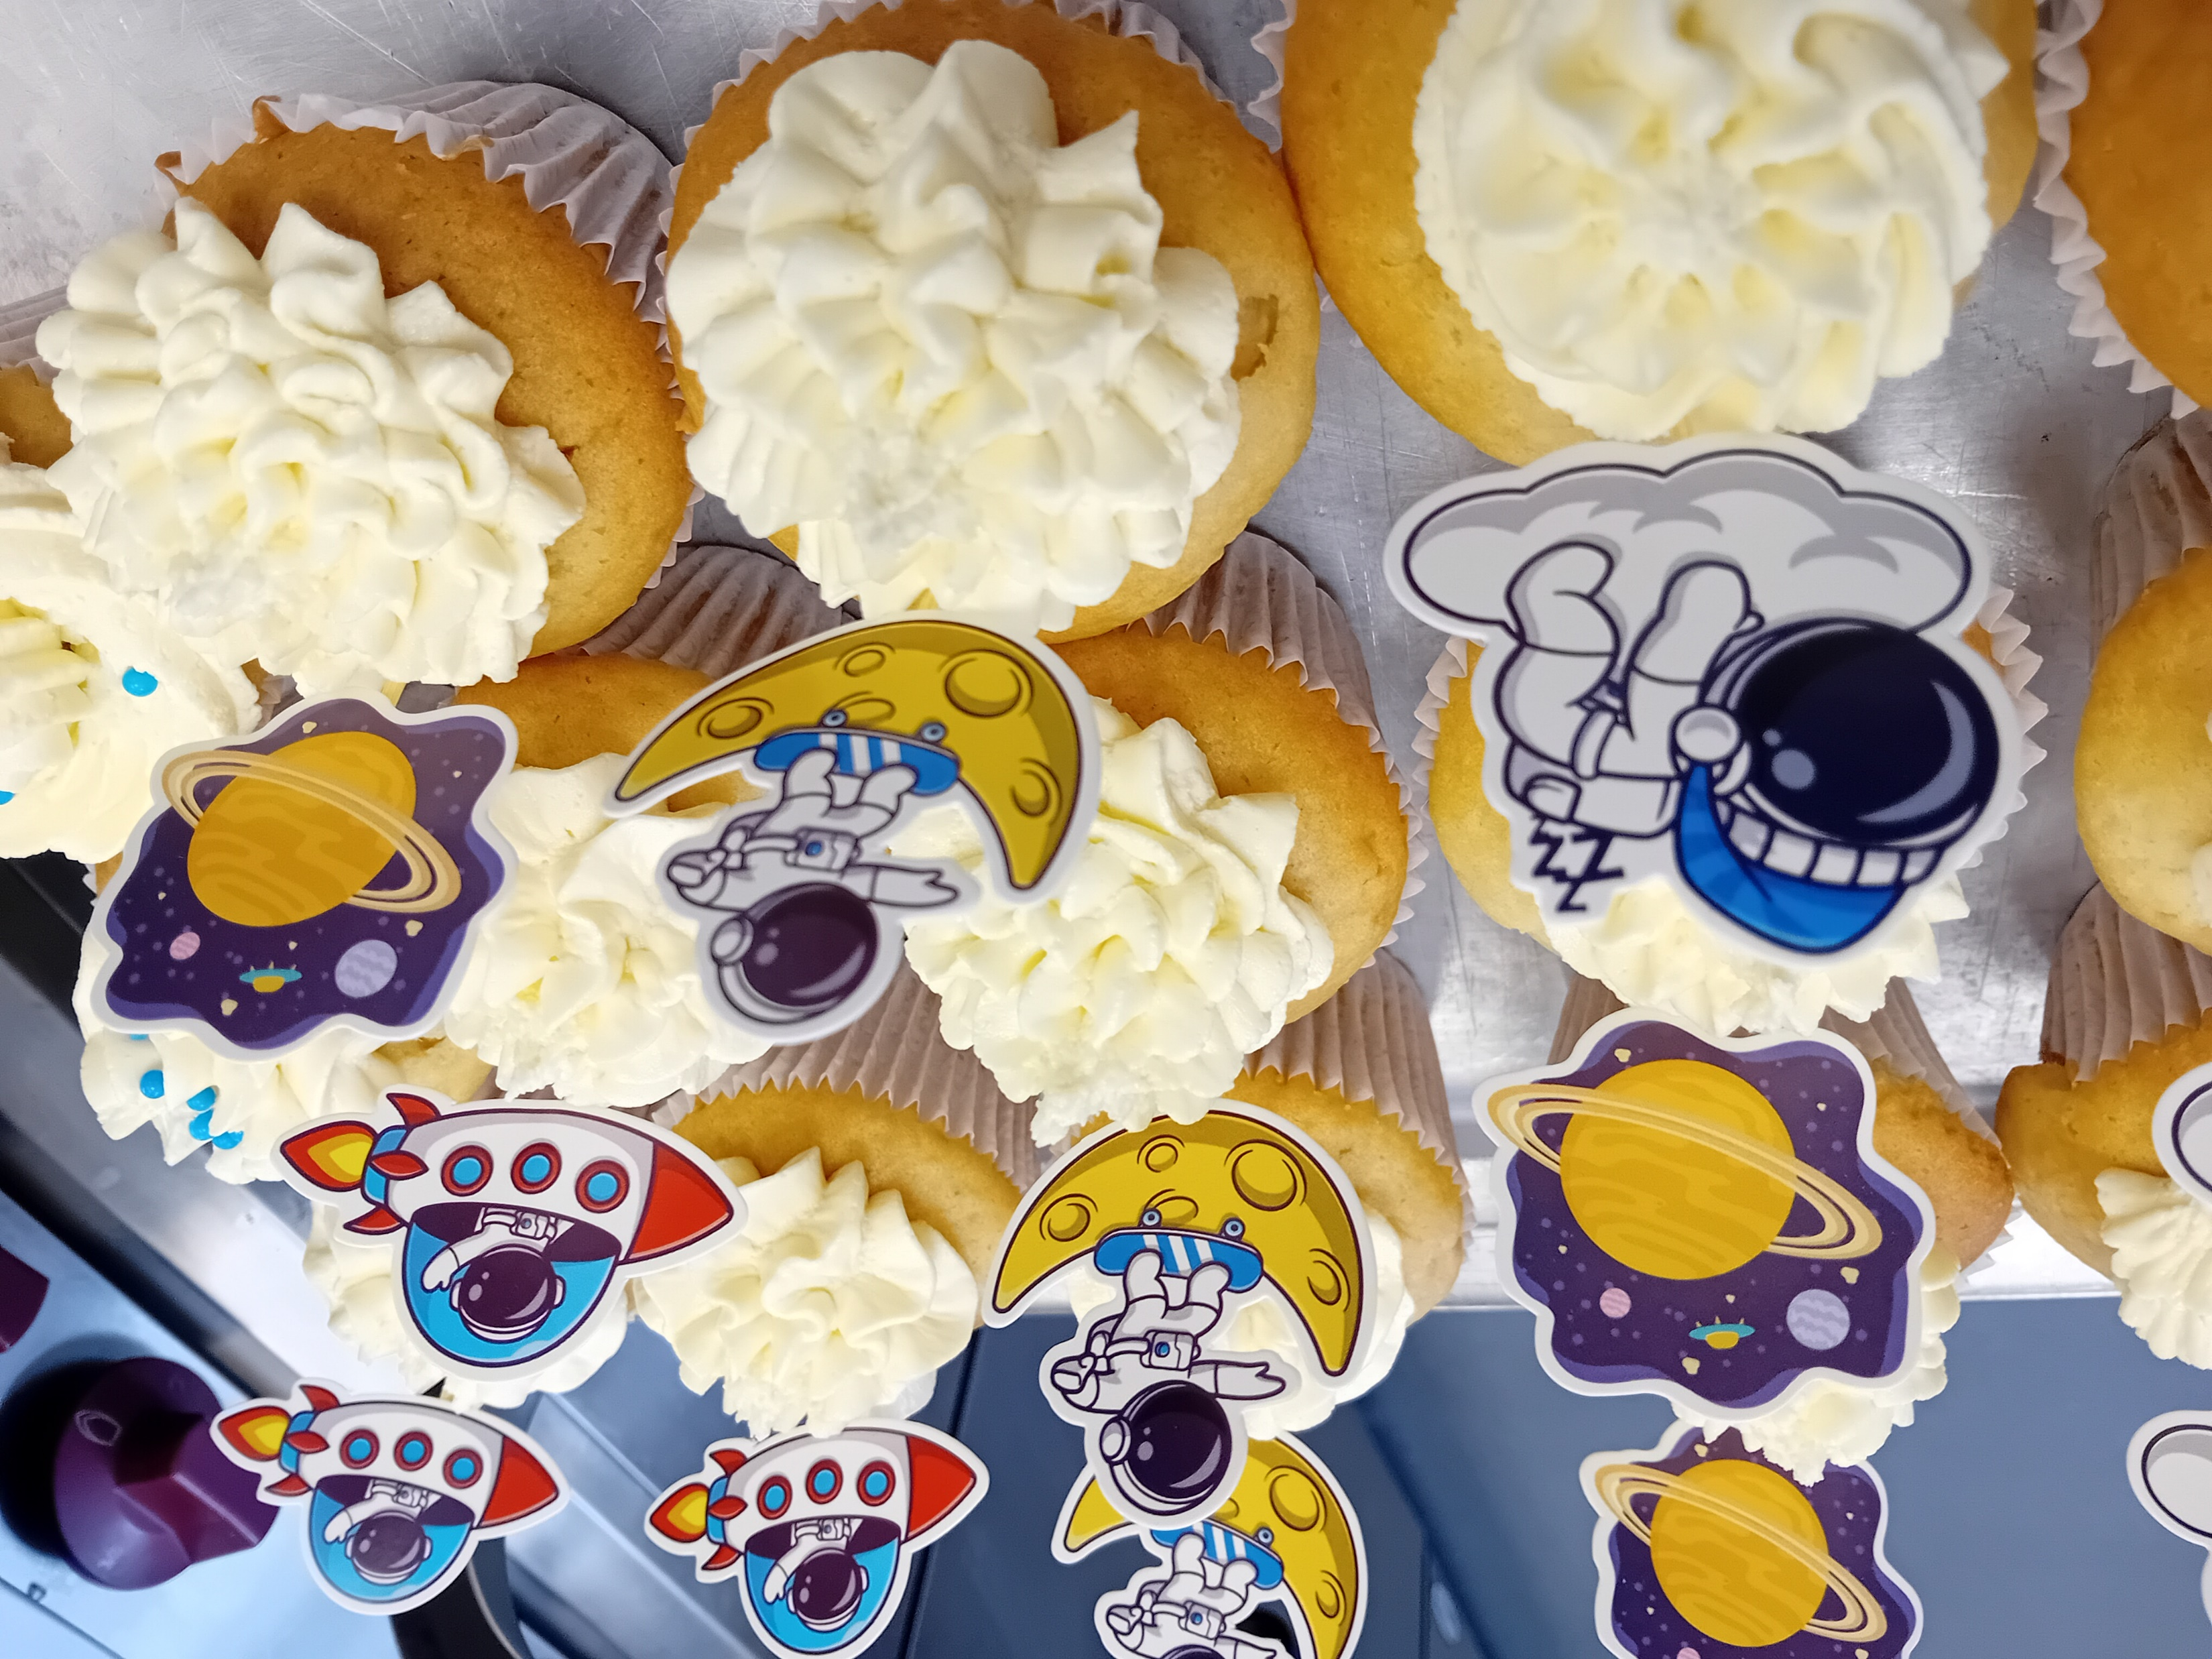
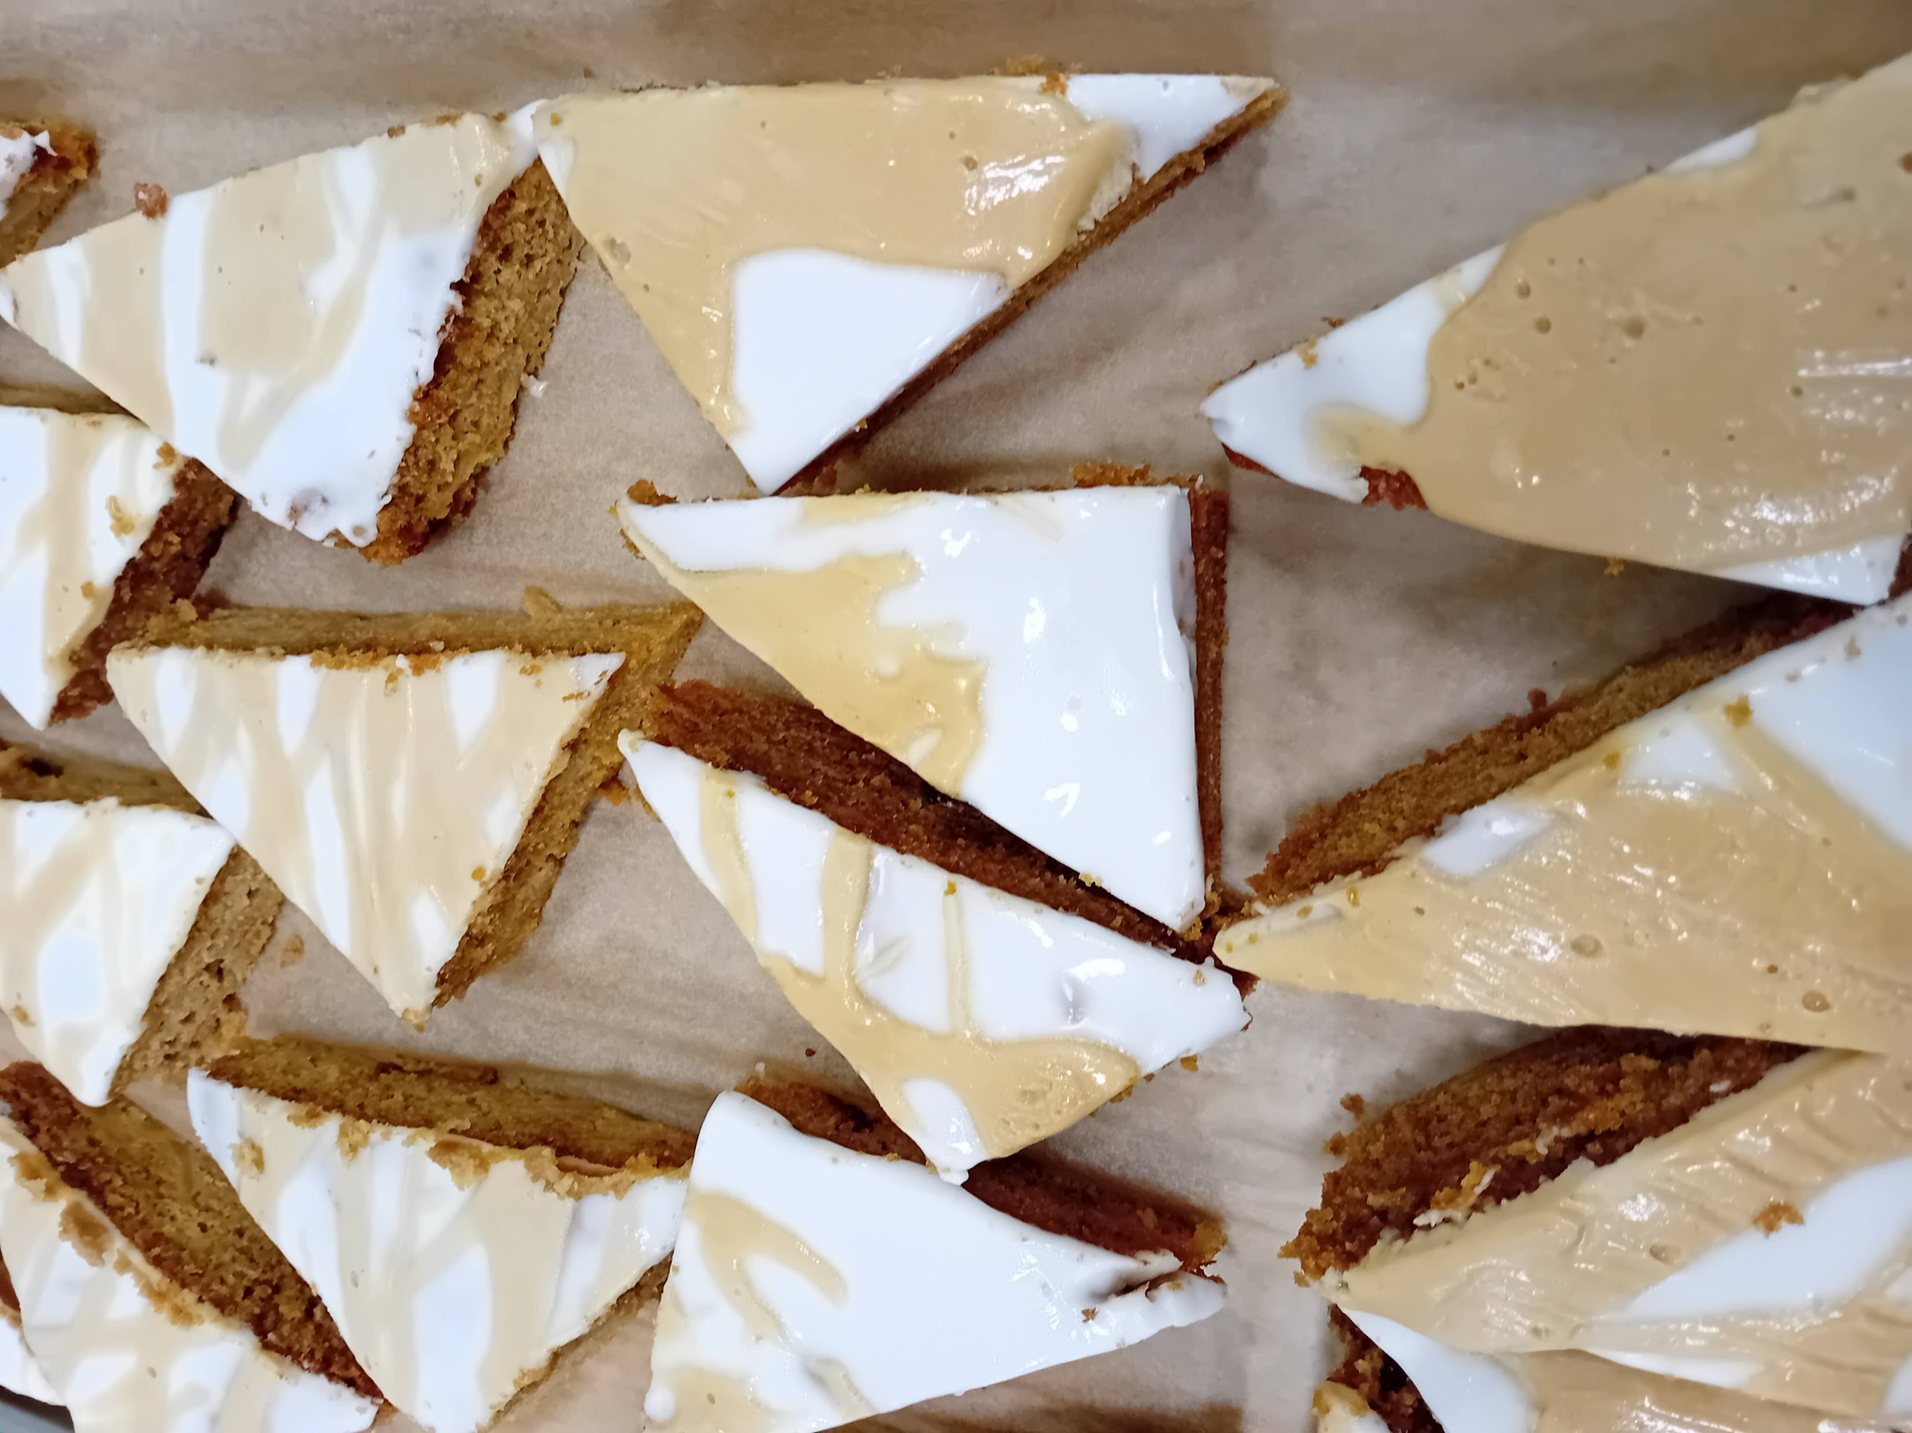
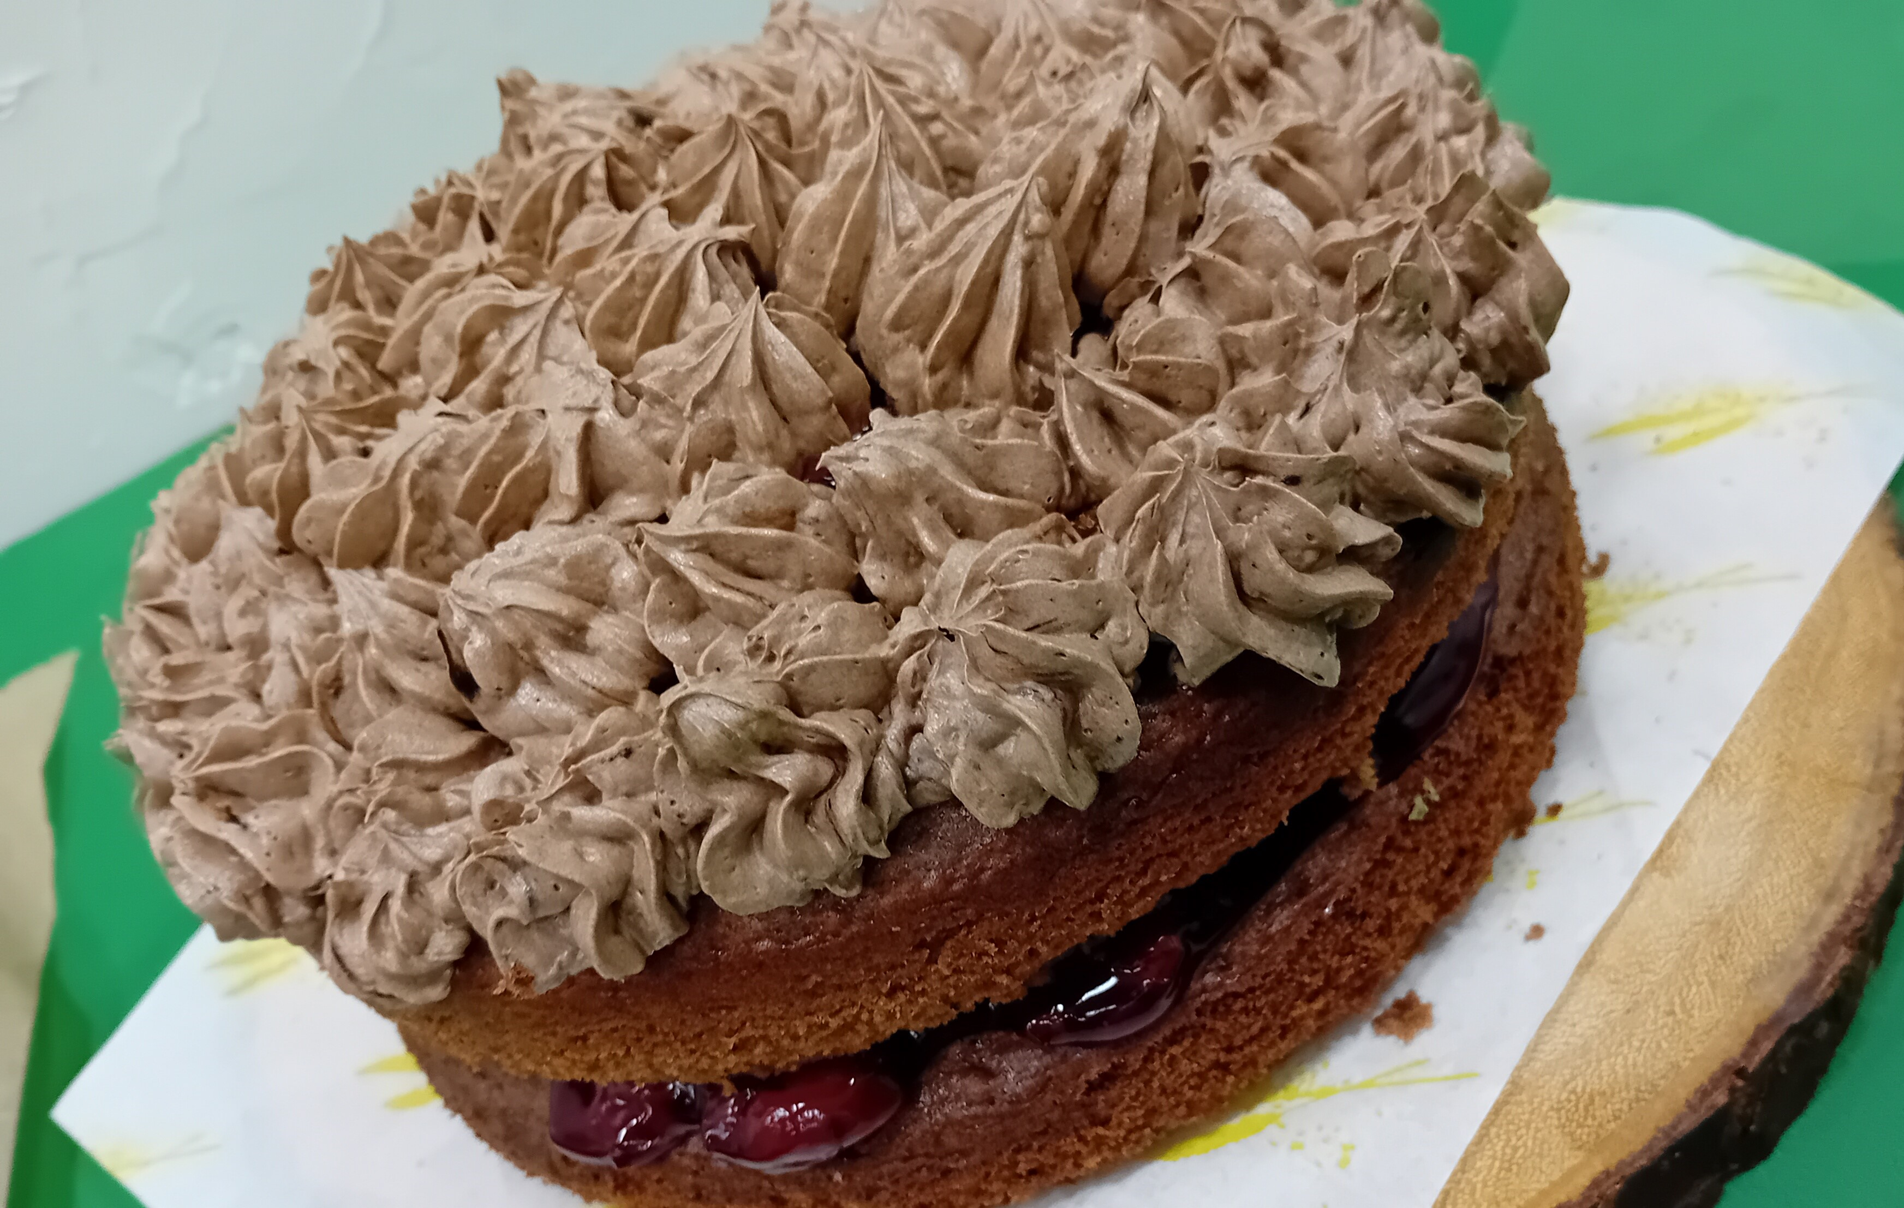
So, what have we been up to in Oct…
It was a very short month , but as always, we packed a lot in …
We supported the school celebrating World Space Day
We donated two homemade cakes for the Macmillan Coffee Morning
We served up added extra’s for the Census Day
& we had plenty sweet treats to celebrate Halloween

Slide 3
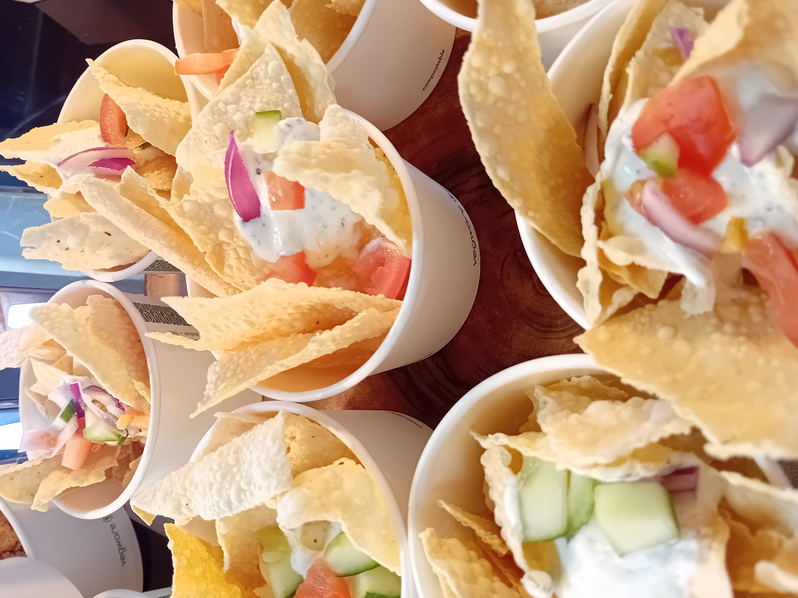
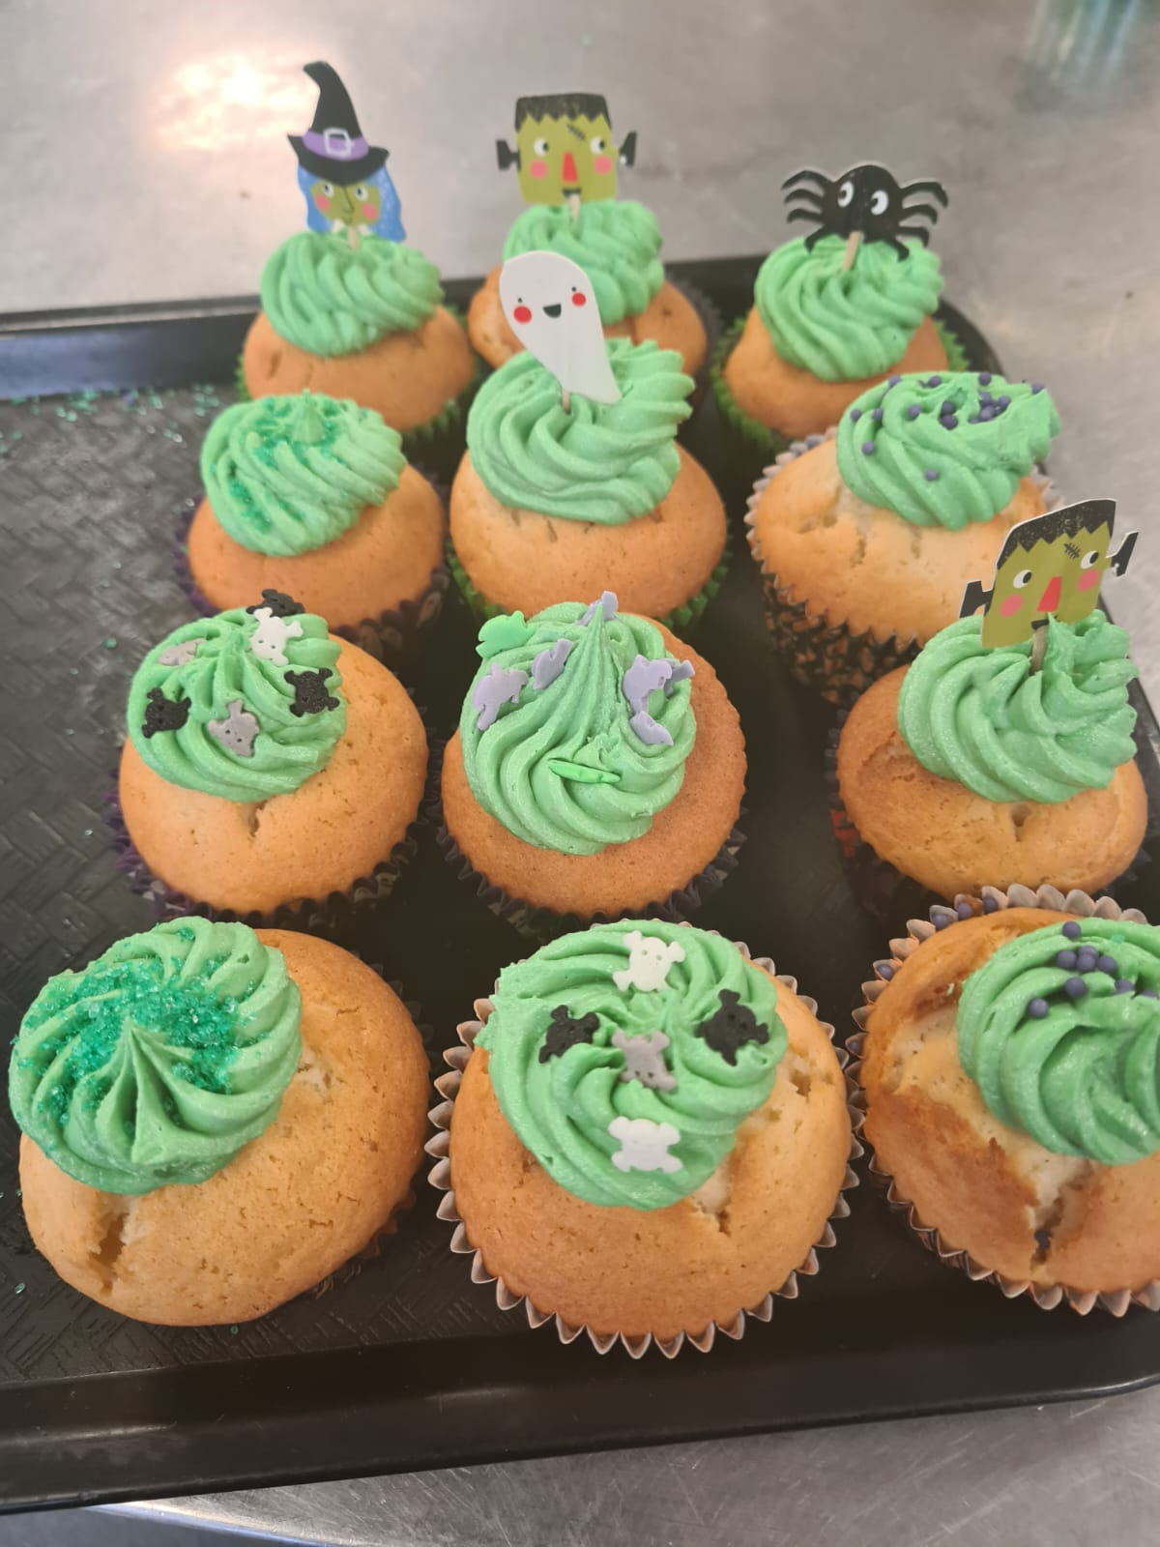
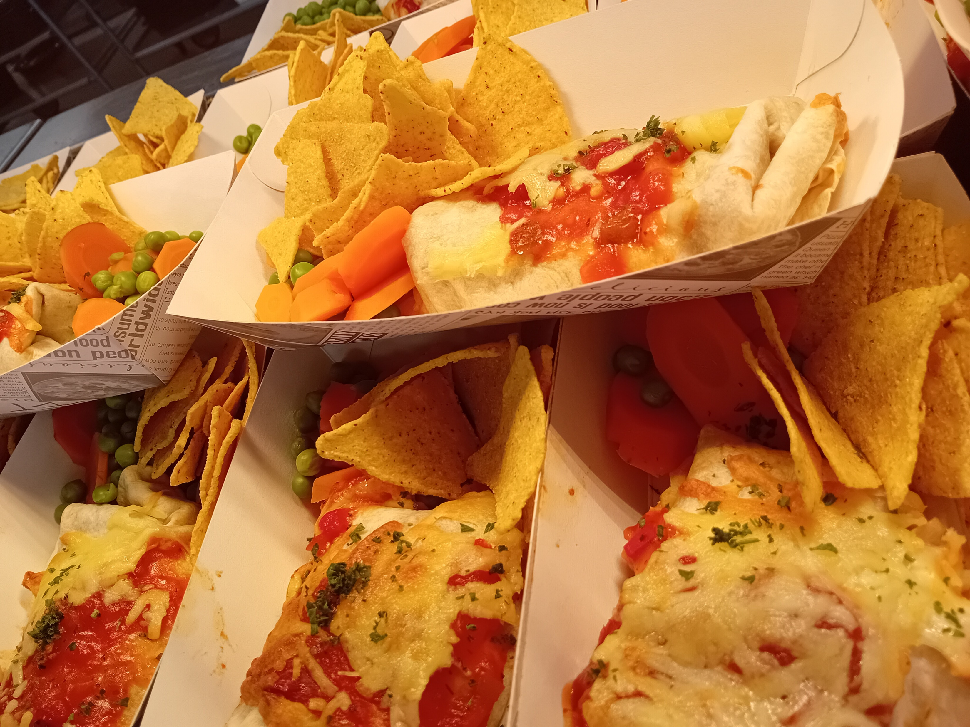
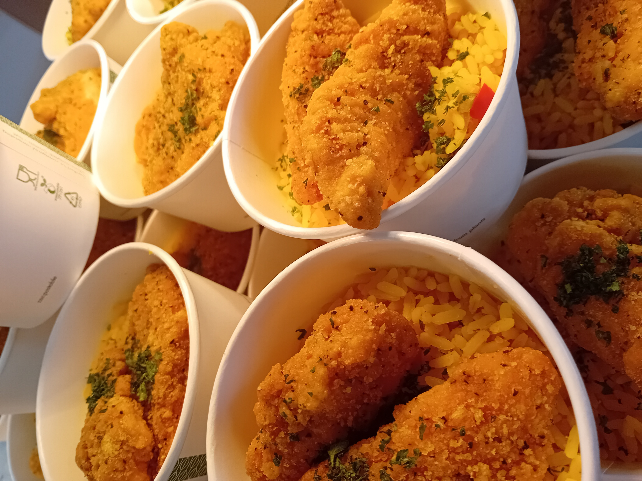
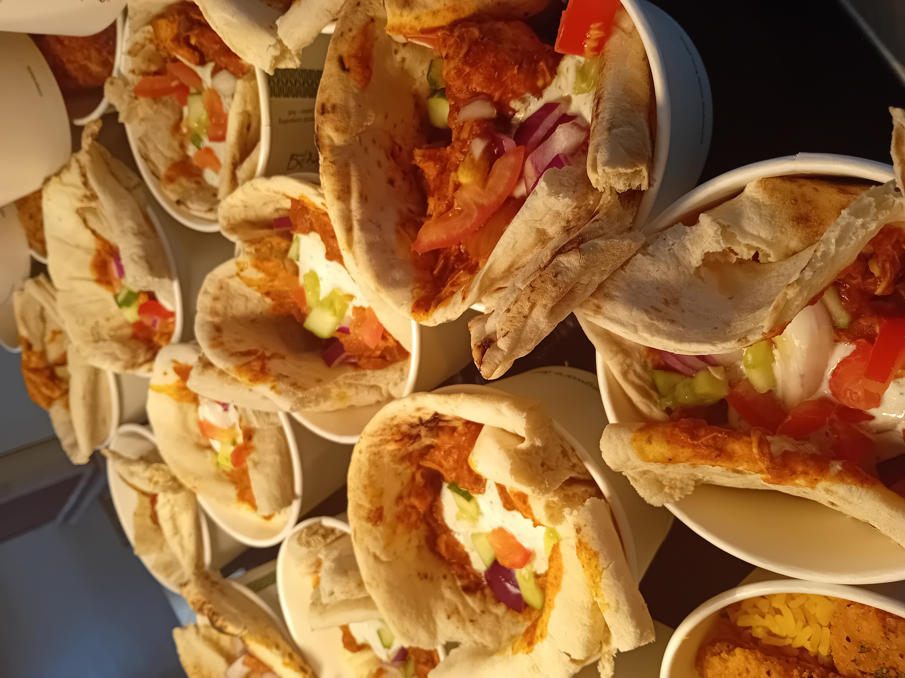
It’s Been a Tasty One!

Slide 4
October Updates & Goings On -
New School Year Menus are going great , had amazing feedback from both students & staff
Fabulous comments & praise from the Open Evening where tasters of our new menus were available
Sixth Formers
We are back recruiting for student till operators at Break & or Lunchtimes
Get paid during your free time by helping us out & add to your CV – enquire at the canteen
£5.00 Food Spend Limit
There is a set limit of £5.00 a day
We have in the past given leeway to avoid students going hungry , but this is causing a lot of complaints of regular overspending & so we are no longer allowing this to happen
Please speak to your children about budgeting for their daily spend
We have lots of Meal Deal Options at £2.50 which can include a Dessert & / or Drink
We also at Breakfast 8am-8.50am offer Free Toast & Squash
There are water fountains throughout the school
Please take advantage of these offers
Alternatively, Parents can email & change the daily limit to suit their child's needs

