Slide 1
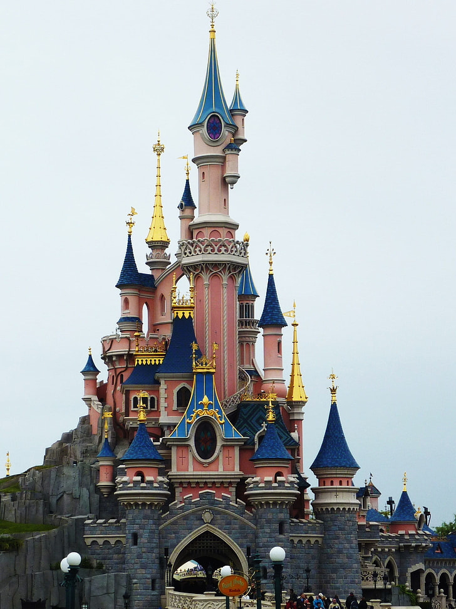
Open to
Year 7 & 8 Students
Friday to Sunday
11TH TO 13TH APRIL 2025

Slide 2
WHY DISNEYLAND!
Students will experience a visit to a different country, to experience the wider world and to travel. They will also make memories that they will remember for years to come.
Within the parks students will have the independence to visit both Disneyland Park and Walt Disney Studios in groups. They will have to plan which of the thrilling rides, street parades and shows in the five incredible lands they want to see.
Learn some independence of being away from home. They will be responsible for their own timekeeping and personal items.

Slide 3
SAMPLE ITINERARY
This itinerary is for illustrative purposes only
All timings will be finalised after booking and are subject to availability.

Slide 4
Day One
Friday 11th April 2025
01.30 Coach arrives at Idsall
02.00 Depart school
07.30 Arrive Dover
09.30 Ferry Crossing (meal voucher on ferry)
12.00 Arrive at Calais (Dunkirk)
16.30 Arrive in Paris. Enjoy a Bateaux Mouches boat cruise on the River Seine.
19.00 Arrive at accommodation and check in (start of driver’s statutory rest period)
Time for evening meal in local restaurant

Slide 5
Day Two
Saturday 12th April 2025
Breakfast at the accommodation
Coach travel to Disneyland Paris for a full day
(Plan to arrive for 09.00 and leave around 21.00)
The ticket gives group access to both the main Disneyland Park and Walt Disney Studios.
(Students will not be allowed in Disney Village)
Marne Le Vallee is about 28.5 km from Disneyland (around half hour travel)
A meal voucher will be given to all students to get
an evening meal
Meet the coach to transfer back to the accommodation

Slide 6
Day Three
Sunday 13th April 2025
07.00 Breakfast at the accommodation
10.00 Depart Hotel (packed lunch supplied)
14.30 Arrive at Calais (Dunkirk)
16.30 Ferry Crossing (meal voucher on ferry)
17.00 Arrive at Dover
22.30 Arrive back at school (there will be a service station stop on the way to Idsall)

Slide 7
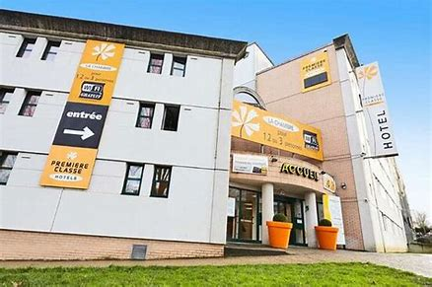
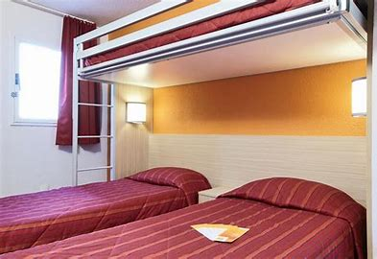
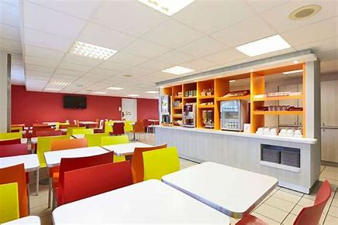
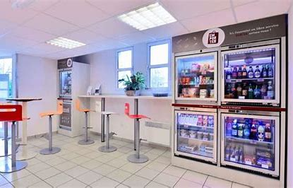
HOTEL
Hotel Premiere Classe
Saint Thibault Des Vignes.
(not guaranteed this hotel)
Rooms will be allocated, as best we can, within year group and within friendship groups. The rooms are multi bed rooms 2, 3 or 4 students per room.
Triple rooms are equipped with bunk bed for the third person. Quadruple rooms consist of a double bed + 1 bunk bed and a single bed.
All rooms will have ensuite.
The hotel is modern, comfortable and affordable.
All-you-can-eat breakfast buffet and free WiFi.

Slide 8
STUDENTS
The Day in Disneyland
Students will be allowed to go off in groups of 4 once we are all in Disneyland.
Students will have access to Disneyland Park and Walt Disney Studios.
Staff will be contactable throughout the day with each group being given a mobile number to ring if they get into any issues – this will be on ID cards that will be issued to every student
A member of staff will be in a pre-arranged place throughout the day - one in each of the parks
Students will be given times to check in throughout the day.
Students will have a time and place to meet back at the end of the day.
Staff will be walking around the park

Slide 9
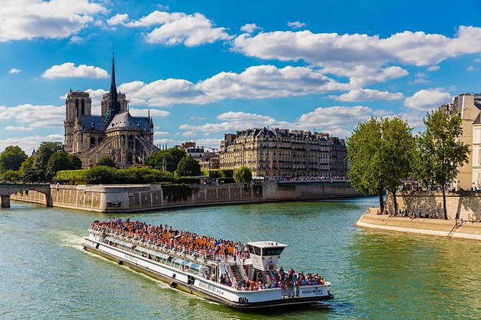
BATEAUX MOUCHES
You can’t go to Paris and not see some of the sights and what better way than by a cruise along the River Seine through the heart of Paris.
We will be hopping onto a boat and enjoying over an hour long tour down the Seine.
The tour starts at the foot of the Eiffel Tower and we will see the sights such as:
Notre Dame,
The Louvre,
Town Hall
Conciergerie
And many more.

Slide 10
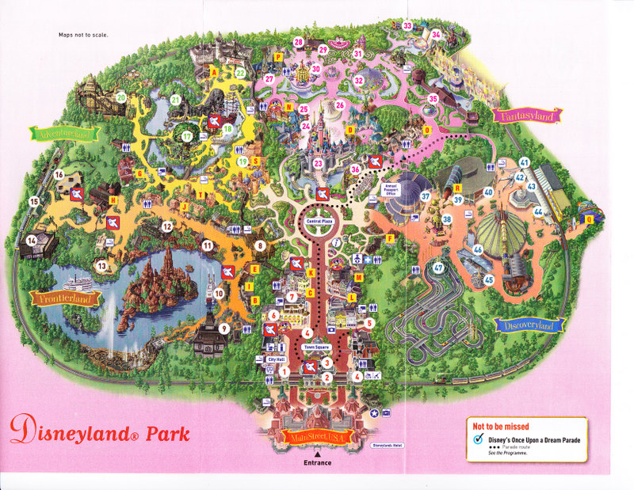
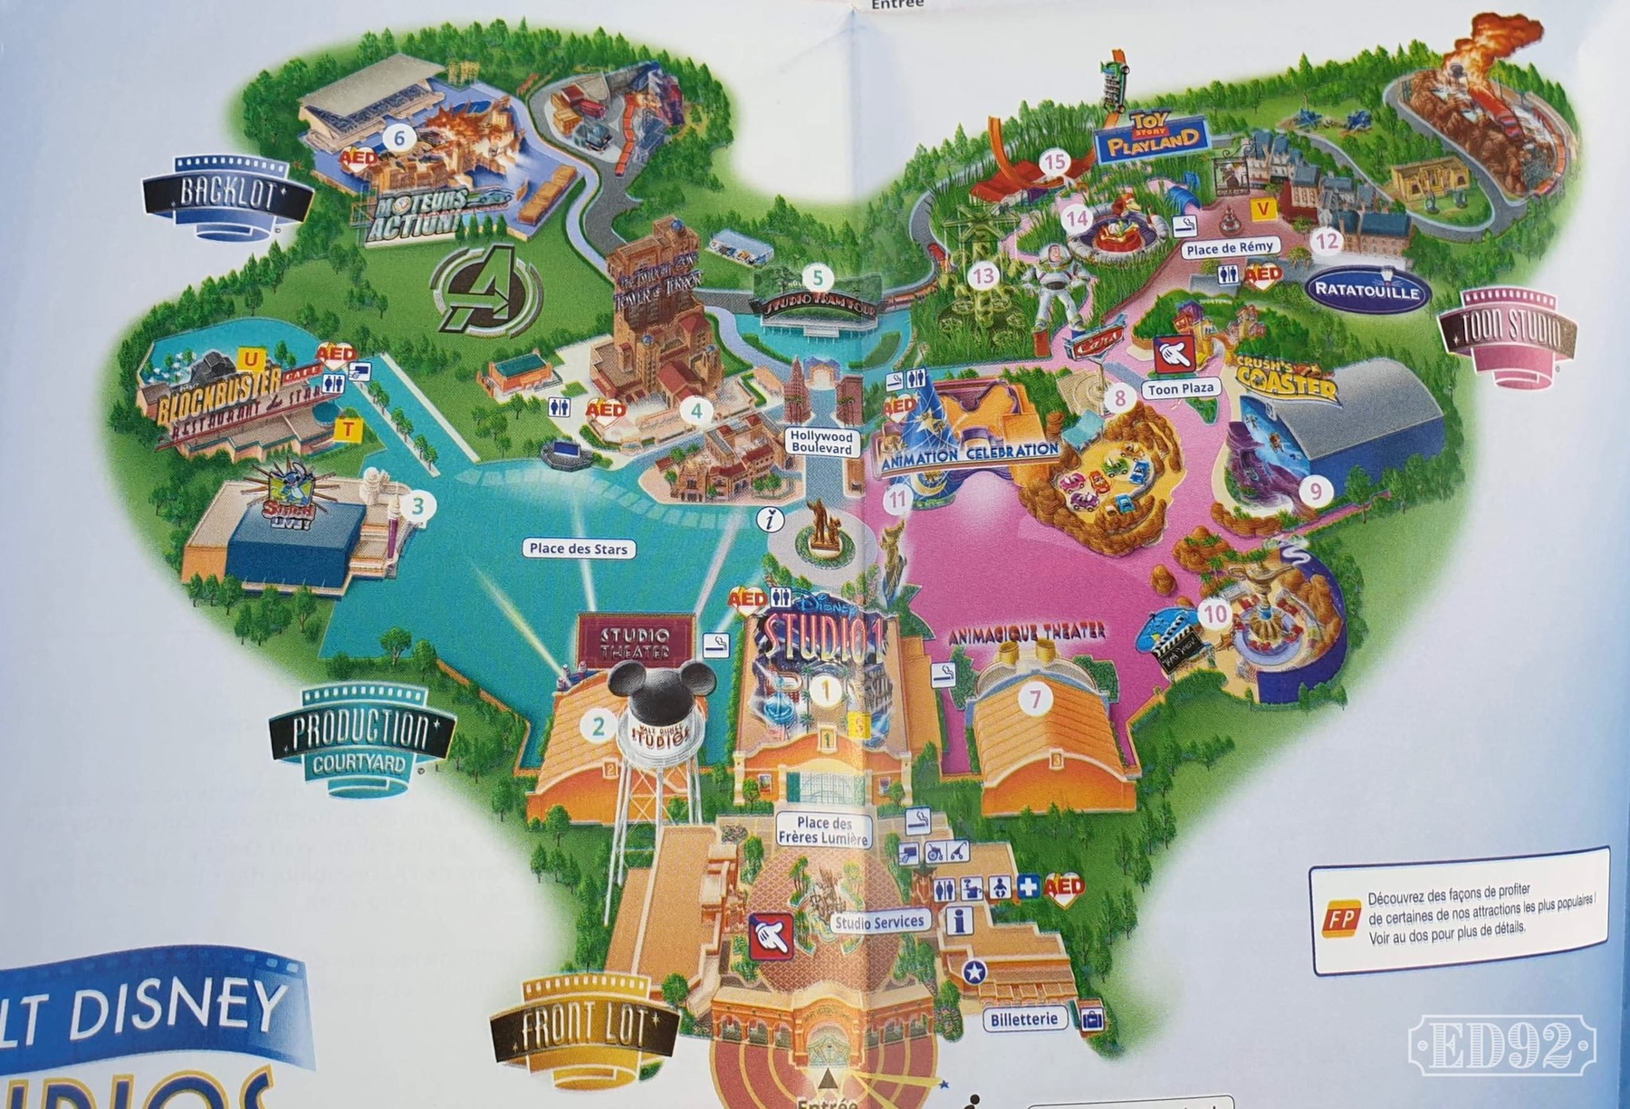
THE PARKS

Slide 11
WHAT IS INCLUDED
Executive Coach Travel (TV/DVD/Video, WC)
Return Channel Crossings
Accommodation for 2 nights’ bed and breakfast (multi occupancy rooms all rooms en-suite
Evening meal included on the day of arrival
A meal voucher to be used for evening meal in Disneyland
Bateaux Mouches Boat Trip along the Seine
Disneyland Paris 2 parks/1 day ticket – this includes the cost of all the rides / parades etc
A packed lunch on day 3
Comprehensive Travel and Medical Insurance through The Marches Academy
Motorway tolls and taxes
VAT at current rates to Tour Operators

Slide 12
OTHER COSTS TO CONSIDER
Spending Money both UK and Euro
Service station stops in both UK and France – include meals on Friday as we travel breakfast and lunch.
Lunch in Disneyland on the Saturday
Drinks / Snacks
Ferry Crossing snacks
Trip Sweatshirt (optional)
Gifts / Souvenirs

Slide 13
COST
The cost of the trip is £475 per student
We have access to take maximum of 60 students (this is with 7 staff)
If it is over subscribed names will be drawn using a computer name generator. Students who went in 2024 will be drawn after.
Deposit of £60 per paying passenger by : 10am on Wednesday 6th November, 2024
2nd Deposit of £215.00 payable by : Thursday 12th December 2024
Final Payment of £200.00 payable by : Monday 20th January 2025
Note : If your student does not get a place a full refund of the deposit will be paid
Note : Any damage to rooms caused by your student will be invoiced to you
Note : Deposit is non-refundable once a place has been offered
Note : If you miss a payment deadline the students place will be removed and no monies paid will be refundable.

Slide 14
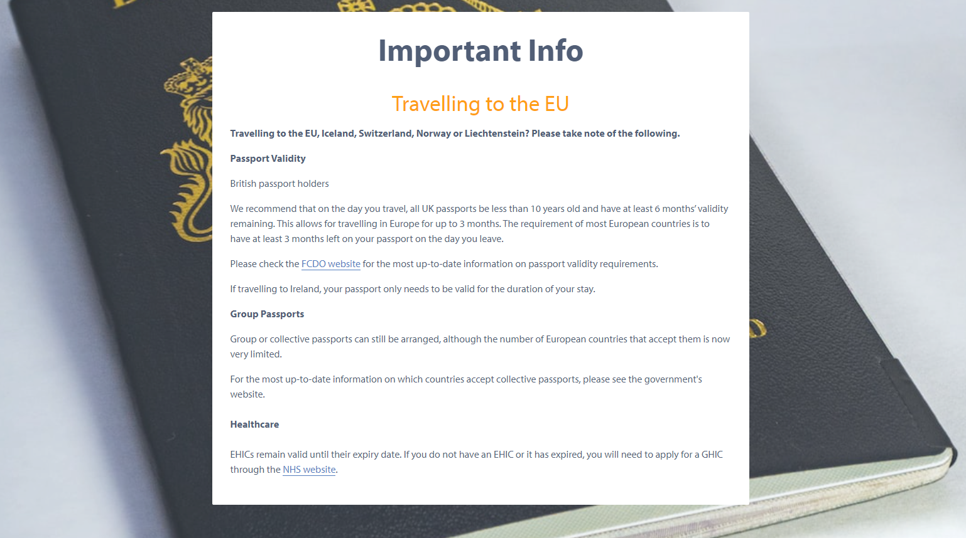
TRAVELLING TO THE EU

Slide 15
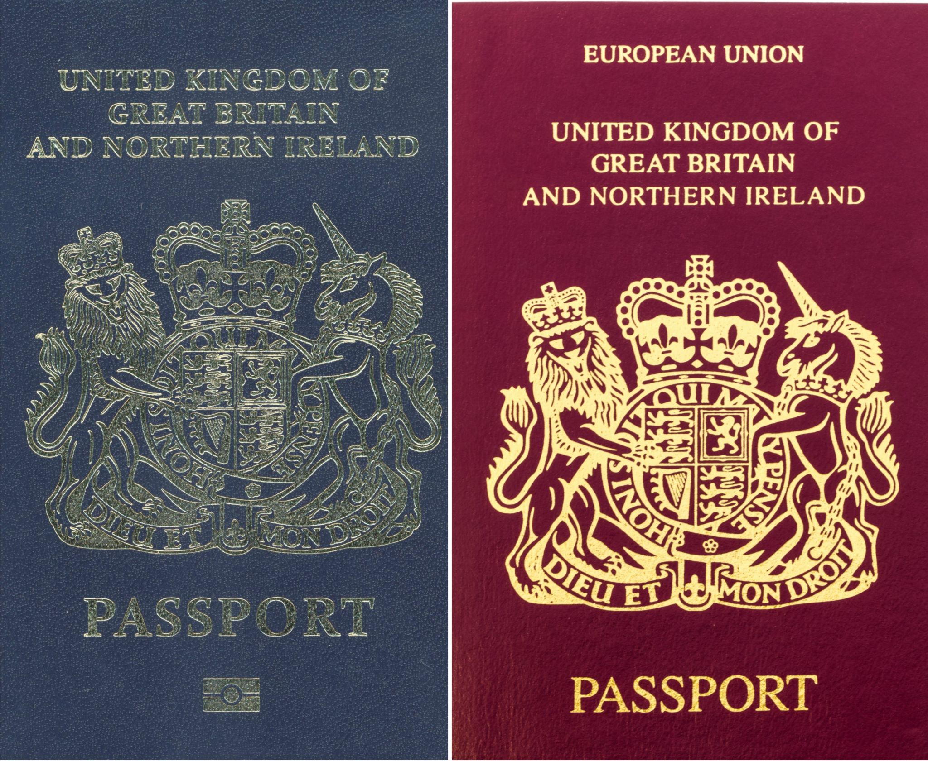
PASSPORTS
British Passport Holders
It is recommended that on the day we travel, all UK passports be less than 10 years old having at least 6 months validity remaining. The requirement of most European countries is to have at least 3 months left on the day you leave.

Slide 16
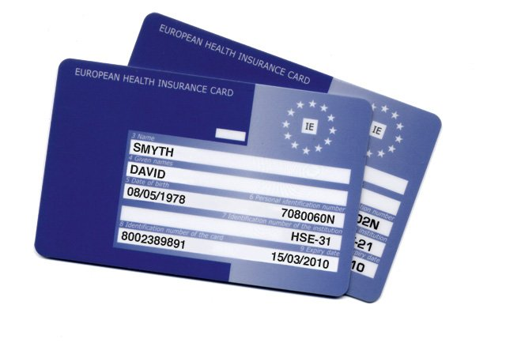
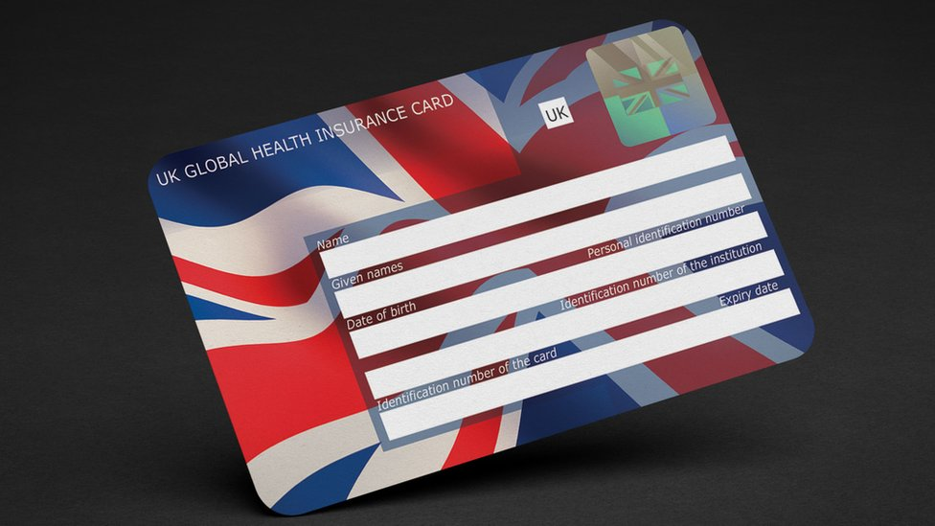
EHIC / GHIC
EHIC cards remain valid until their expiry date.
If you do not have an EHIC or it has expired, you will need to apply for a GHIC through the NHS Website.
These are free of charge but essential for students to travel.
Applying for healthcare cover abroad (GHIC and EHIC) - NHS (www.nhs.uk)
Copy this into search bar – open up the one shown above
Scroll down till you see “apply for a GHIC card”
Please do not use any site that asks you to pay
You will need :
Full Name / Address / DOB / NI No

Slide 17
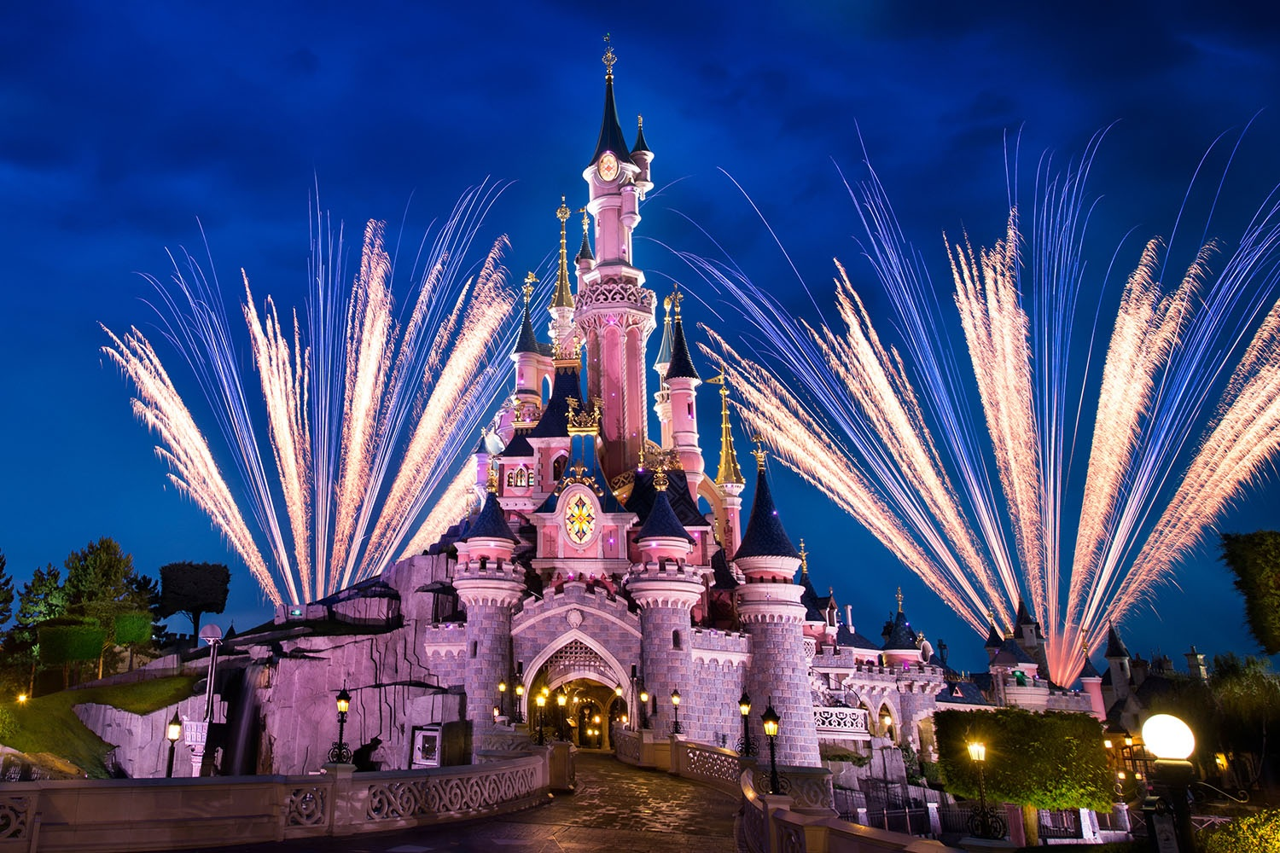
WHAT TO DO NEXT
To request a place on the trip the £60 deposit needs to be paid by 10am on Wednesday 6th November, 2024 and handed to Mrs Rushton in the Finance Office along with the page attached to the letter
This can be done either by cheque or cash. If your student does not get a place this will be refunded in full.
The students that have places will be added to the system and you will be notified as soon as possible.

Slide 18
ANY QUESTIONS
Ask them now as others may have the same question
Email me : Cathy.Leverington@ids.mmat.co.uk
Students can come and see me at any time
Once it is all confirmed, deposits paid, names sorted, possibly groups sorted, I will meet again with students to help plan their day in Disney as they do not want to waste too much time not knowing what to do and where to go next!
There will be a full parental meeting in school in February 2025 prior to the trip.

