Slide 1
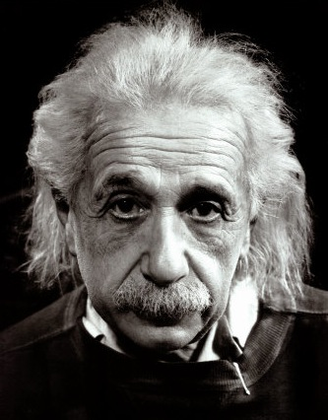
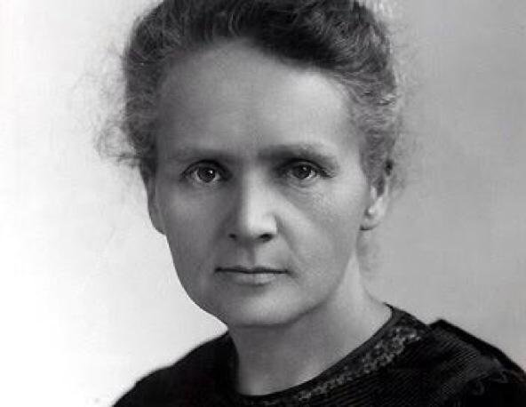
This way to Year 12:
Continuing your journey to scientific greatness.
Idsall School
Year 11 Separate Physics Learning Journey
End of year 7 exam in the summer term:
Build your revision skills, practice and commit key information to your long-term memory. You will be tested on all the content learned over the course of the year ready to recall and build on this knowledge throughout Year 8.
Pillar 3
Assessment
Summer Term
P16: Space: Covering formation of the Solar system, the life history of a star, planets, satellites and orbits, the universe.
Preparation for final examinations
.
Pillar 2
Assessment
Spring Term
P14: Light: Covering reflection, refraction, colour and lens
P15: Electromagnetism: Magnetism and electromagnetism covering the motor effect and electricity generation
Pillar 1
Assessment
Autumn Term
P10 Force and Motion: Newtons Laws of motion related to stopping distance and conservation of momentum
P11 Forces and Pressure: Students will learn about pressure on surfaces, atmospheric pressure and upthrust and floatation.
P12: Wave Properties: Waves properties investigating reflection and refraction
P13: Electromagnetic Waves: Electromagnetic spectrum uses and dangers
KS2: Students will enter Idsall in Year 7 having studied a comprehensive KS2 Science curriculum comprising of Living Things & Habitats, Properties & Changes of Materials, Earth & Space, Light & Sound, Forces & Matter
Start here

