Slide 1
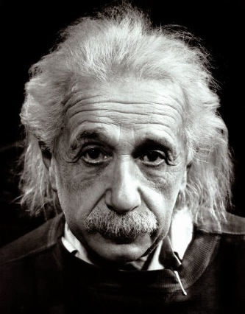

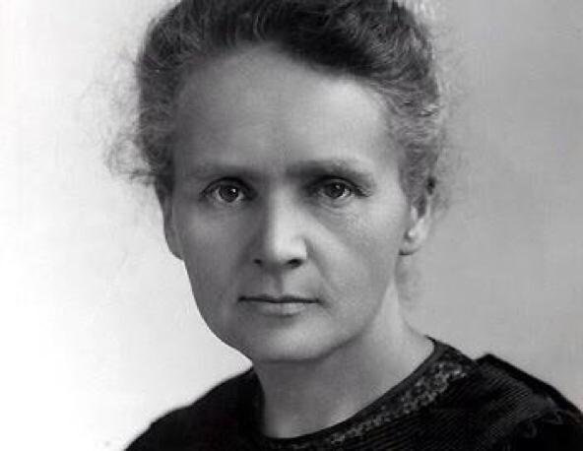

This way to Year 12:
Continuing your journey to scientific greatness.
Idsall School
Year 11 Separate Biology Learning Journey
This Photo by Unknown Author is licensed under CC BY-SA-NC
This Photo by Unknown Author is licensed under CC BY-SA
GCSE exams in the summer term:
Build your revision skills, practice and commit key information to your long-term memory. You will be tested on all the content learned over the course of year 10 & year 11
Pillar 3
Assessment
Summer Term
B18 Biodiversity & Ecosystems : All species live in ecosystems composed of complex communities of animals and plants dependent on each other and that are adapted to particular conditions, both abiotic and biotic. These ecosystems provide essential services that support human life and continued development.
GCSE Exam period
Spring Term
Pillar 2
Assessment
B15 Genetics & Evolution: Scientists have now discovered how to take genes from one species and introduce them into the genome of another by a process called genetic engineering. In spite of the huge potential benefits that this technology can offer, genetic modification still remains highly controversial.
B16: Adaptations, Interdependence & Competition: Students will study communities including the interdependence of all the species present, environmental factors and be able to give real examples to illustrate interdependence.
Core practical's
B17 Organising an Ecosystem: living organisms may form populations of single species, communities of many species and ecosystems, interacting with each other, with the environment and with humans in many different ways
Pillar 1
Assessment
Autumn Term
B11 Hormonal Coordination: Students should be able to explain that homeostasis is the regulation of a cell or organism's internal conditions to maintain optimal functioning in response to internal and external changes, ensuring ideal conditions for enzyme activity and cellular functions.
B12: Homeostasis in Action: Body temperature is monitored and controlled by the thermoregulatory centre in the brain. Students also learn how water and nitrogen are balanced in the body
B13 Reproduction: This section explores how meiosis halves the number of chromosomes and combines them with new genes from a partner to create unique offspring. Gene mutations occur continuously and can occasionally impact the functioning of animals or plants
B14 Variation & Evolution: Variation from mutations and sexual reproduction fuels natural selection and species evolution. Scientists apply this knowledge in selective breeding to enhance livestock traits, while cloning can produce multiple identical individuals with those traits.
KS3: Students will enter into Year 10 having studied a comprehensive KS3 Science curriculum comprising of Cells, reproduction, Health & lifestyle, inheritance, ecosystems & adaptations and biological processes
Start here

