Slide 1
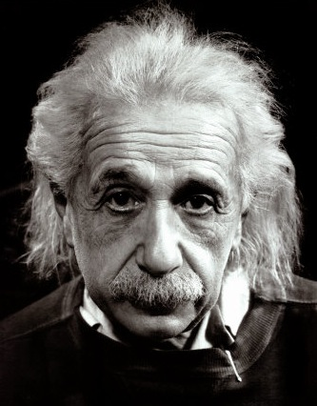
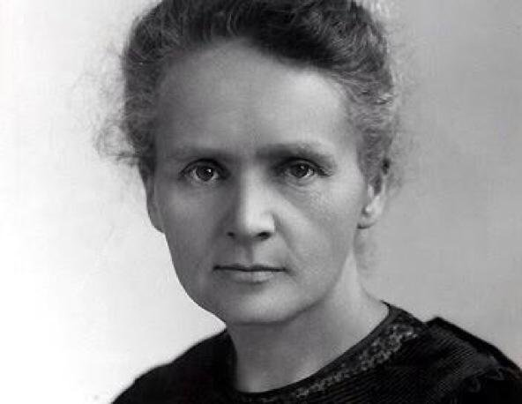
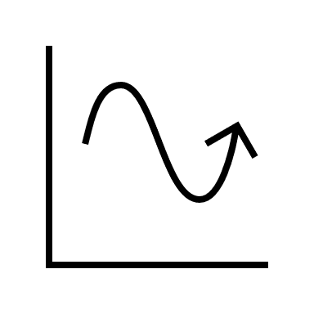
This way to Year 12:
Continuing your journey to scientific greatness.
Idsall School
Year 11 Learning Journey
GCSE exams in the summer term:
Build your revision skills, practice and commit key information to your long-term memory.
Pillar 3
Assessment
Summer Term
Preparation for final examinations
.
Pillar 2
Assessment
Spring Term
P12: Electromagnetic Waves: Electromagnetic spectrum uses and dangers
P13: Electromagnetism: Magnetism and electromagnetism covering the motor effect and electricity generation
Pillar 1
Assessment
Autumn Term
P10 Force and Motion: Newtons Laws of motion related to stopping distance and conservation of momentum
P11: Wave Properties: Waves properties investigating reflection and refraction
KS4 Physics:
Students begin year 11 by extending their learning around forces and motion including Newton’s Laws of Motion and real life applications of motion calculations
Start here

