Slide 1
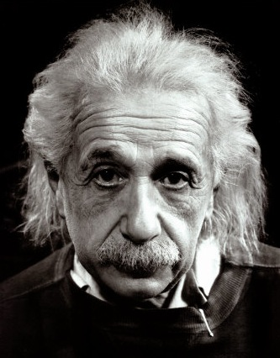
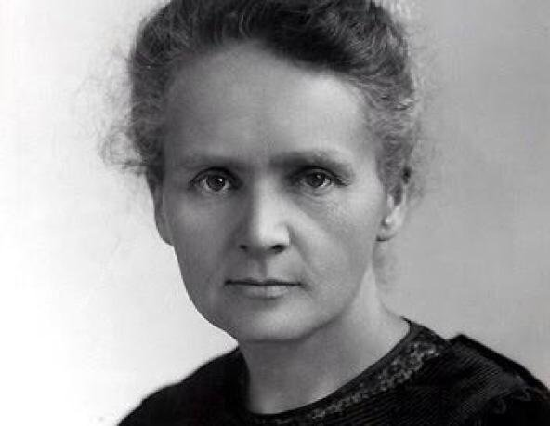
This way to Year 12:
Continuing your journey to scientific greatness.
Idsall School
Year 11 Combined Biology Learning Journey
This Photo by Unknown Author is licensed under CC BY-SA-NC
This Photo by Unknown Author is licensed under CC BY-SA
GCSE exams in the summer term:
Build your revision skills, practice and commit key information to your long-term memory. You will be tested on all the content learned over the course of year 10 & year 11
Pillar 3
Assessment
Summer Term
B15: Adaptations, Interdependence & Competition: Students will study communities including the interdependence of all the species present, environmental factors and be able to give real examples to illustrate interdependence.
Core practical's
GCSE Exam period
Spring Term
Pillar 2
Assessment
B14 Genetics & Evolution: Scientists have now discovered how to take genes from one species and introduce them in to the genome of another by a process called genetic engineering. In spite of the huge potential benefits that this technology can offer, genetic modification still remains highly controversial.
B17 Biodiversity & Ecosystems : All species live in ecosystems composed of complex communities of animals and plants dependent on each other and that are adapted to particular conditions, both abiotic and biotic. These ecosystems provide essential services that support human life and continued development.
B16 Organising an Ecosystem: living organisms may form populations of single species, communities of many species and ecosystems, interacting with each other, with the environment and with humans in many different ways
Pillar 1
Assessment
Autumn Term
B11 Hormonal Coordination: Students should be able to explain that homeostasis is the regulation of the internal conditions of a cell or organism to maintain optimum conditions for function in response to internal and external changes. Homeostasis maintains optimal conditions for enzyme action and all cell functions.
B12 Reproduction: In this section we will discover how the number of chromosomes are halved during meiosis and then combined with new genes from the sexual partner to produce unique offspring. Gene mutations occur continuously and on rare occasions can affect the functioning of the animal or plant.
B13 Variation & Evolution: Variation generated by mutations and sexual reproduction is the basis for natural selection; this is how species evolve. An understanding of these processes has allowed scientists to intervene through selective breeding to produce livestock with favoured characteristics. Once new varieties of plants or animals have been produced it is possible to clone individuals to produce larger numbers of identical individuals all carrying the favourable characteristic.
KS3: Students will enter into Year 10 having studied a comprehensive KS3 Science curriculum comprising of Cells, reproduction, Health & lifestyle, inheritance, ecosystems & adaptations and biological processes
Start here

