Slide 1
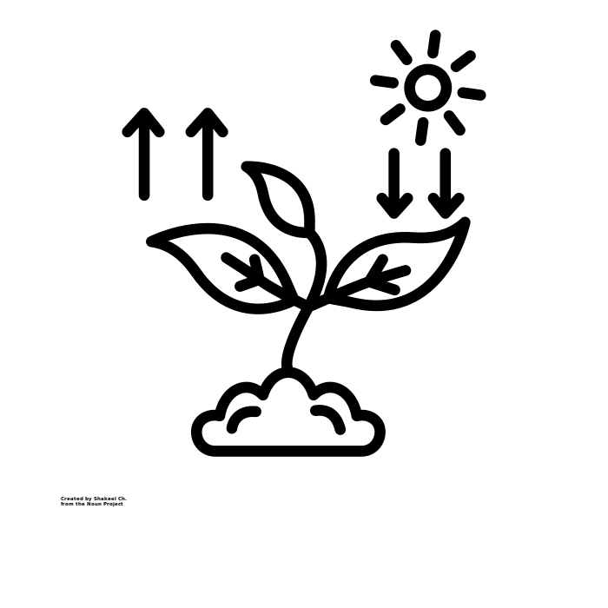
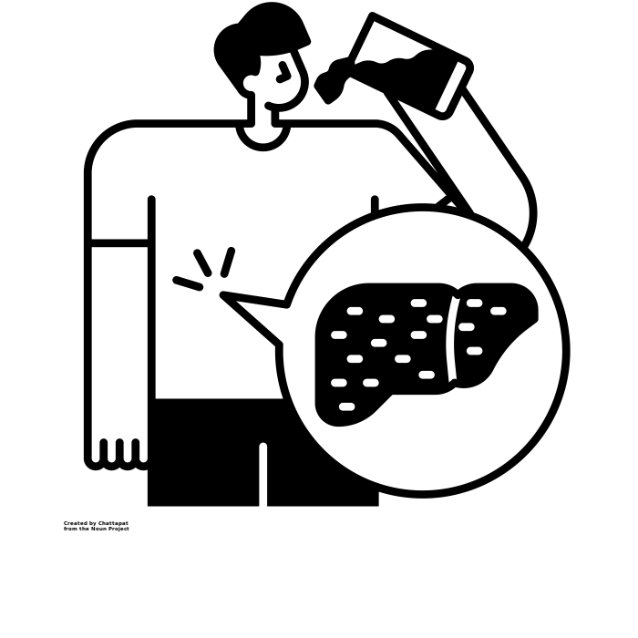
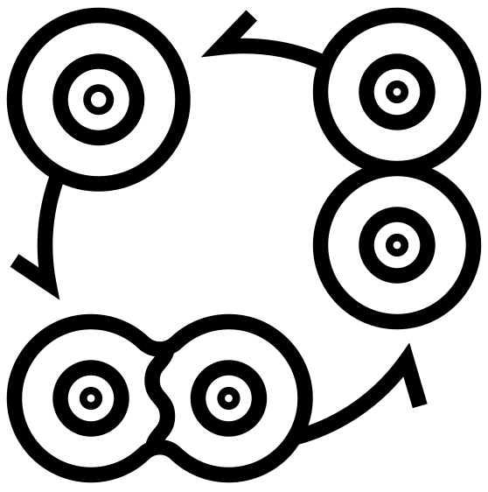
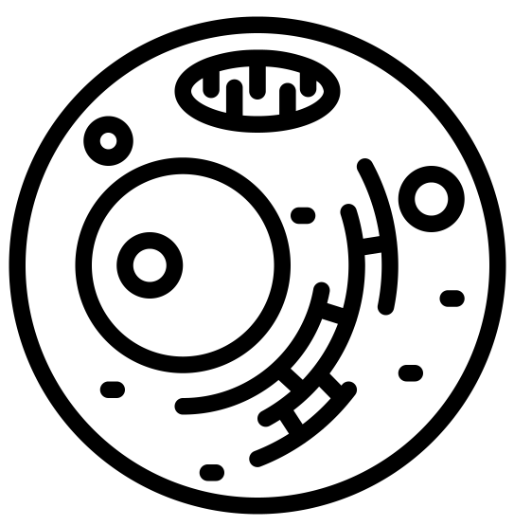
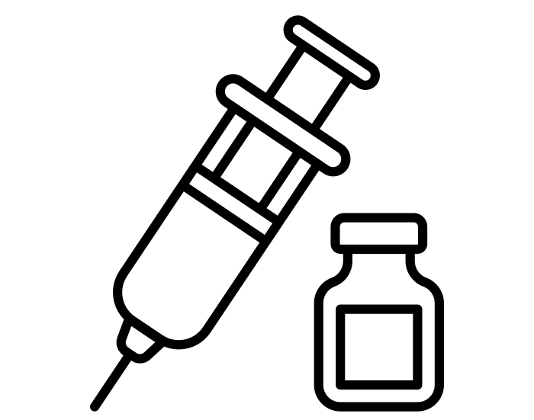
This way to Year 11:
Continuing your journey to scientific greatness.
Idsall School
Year 10 Learning Journey
End of year 10 exam in the summer term:
Build your revision skills, practice and commit key information to your long-term memory. You will be tested on all the content learned over the course of the year ready to recall and build on this knowledge throughout Year 10.
Pillar 3
Assessment
Summer Term
B10: Human Nervous System: The nervous system enables humans to react to their surroundings and to coordinate their behaviour. Students should be able to explain how the structure of the nervous system is adapted to its functions
B15: Adaptations, Interdependence & Competition: Students will study communities including the interdependence of all the species present, environmental factors and be able to give real examples to illustrate interdependence.
Core practical's
Spring Term
Pillar 2
Assessment
B6 Preventing Infection and Treating Disease: Students will learn about ways of treating disease including; vaccination, antibiotics and painkillers. The use of monoclonal antibodies will also be studied.
B7 Non - communicable Diseases: Students will study different risk factors for disease including smoking and cancer and will use data to help them to draw conclusions about causes of disease.
B8 Photosynthesis: Students will study photosynthesis in both plants and algae and any limiting factors that will affect the rate. Adaptations of the leaf to maximise photosynthesis is also studied.
B9 Respiration: This topic looks at one of the most important processes in cells of respiration. Metabolism, aerobic and anaerobic respiration will all be covered in this topic.
Pillar 1
Assessment
Autumn Term
B3 Organisation & Digestion: Students will learn about the human digestive system which provides the body with nutrients and how enzymes work.
B4 Organising animals & plants: Content includes circulatory system, heart and blood vessels and plant tissues and transport system.
B5 Communicable Diseases: Content includes pathogens that cause disease, symptoms and treatment of disease.
KS3: Students will have completed a broad curriculum in Years 7- 9 covering many topics including cells, structure and function of living things and health & lifestyle. This will provide the foundations which will be built on over the next two years during the GCSE curriculum.
Start here

