Slide 1
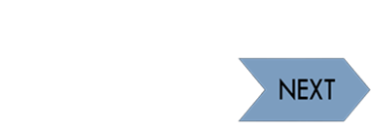




Idsall School
Year 12 A Level Physics Learning Journey
This way to Year 13
Exam Preparation
Build a portfolio of revision material, to help remember content covered and commit key information to long term memory. Make sure you are confident on the content covered this year, so you are ready to build upon this in Year 13.
Preparation for Next Year
Materials
YEAR 12 EXAMS
Thermal Physcs
Circular Motion
Summer Term
Revision Techniques
Revise over content covered so far. Make sure you practice exam skills and ensure you know your scientific key words. You will be tested on all the content learned over the course of the year ready to build on in Year 13.
Summer Term
Mechanics continued
Electricity
Particles
Spring Term 2
Online resources for KS5:Seneca Learning, A level Physics Online, Physics and Maths Tutor Isaac Physics, Physics Classroom
Spring Term
Measurements and Uncertainty
Waves
Mechanics
Autumn Term
Study skills for KS5: Invest in a textbook and scientific calculator, consolidate your notes after each lesson, follow the published weekly revision schedule, record practical work neatly in lab book, timed questions, use past papers and mark schemes. Use Drop box every day
Autumn Term
GCSE
Students will enter Y12 having worked through a comprehensive KS3 and KS4 Science curriculum comprising elements of: Forces and Motion, Waves, Radioactivity, Electricity, Magnetism and the Particle Narure of Light. Working and thinking scientifically underpins everything that we do.
Start here

